Slide 1
Identifying Conservation Priorities By Combining the Where to with the How to: A Case Study for Implementing Environmental Flows in the Red River Basin
¹Sean Wineland, PhD Student, Science to Action Fellow
¹Dr. Tom Neeson, Advisor
¹Department of Geography and Environmental Sustainability, University of Oklahoma

Slide 2
Declining Biodiversity Highlights Need to Accelerate Implementation of Conservation Initiatives
Terrestrial
Marine
Freshwater
. 38%
. 44%
. 81%
1970-2012 population abundance trends, WWF Living Planet Index
Notes:
I’m going to start off by talking about the sad things and eventually move towards good outcomes in the end of this presentation. So I think a lot about conservation at the global scale to relate to local contexts. If we look at global patterns of biodiversity loss across all systems we’re seeing 40 year population abundance trends declining by almost half in terrestrial and marine ecosystems, and 81% in freshwater systems. This rapid and drastic decline highlights our needs as humans to accelerate the implementation of conservation initiatives.

Slide 3
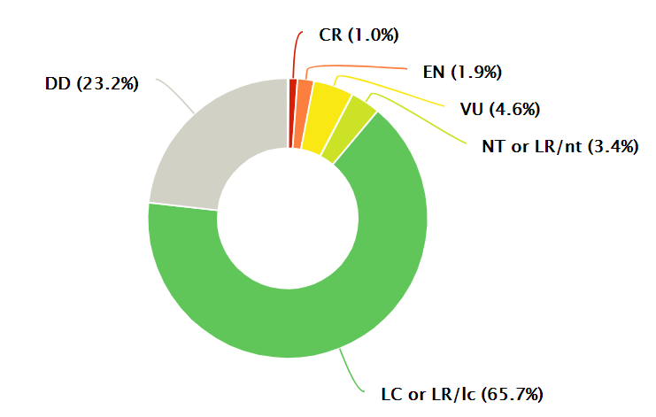
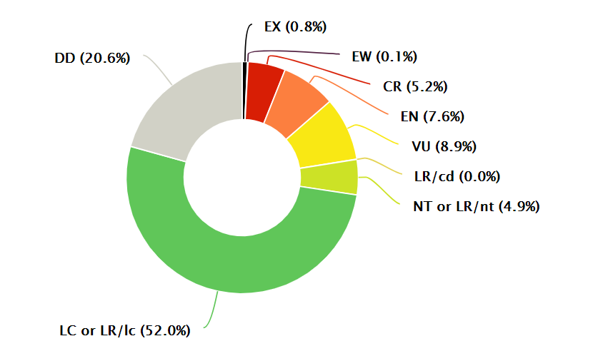
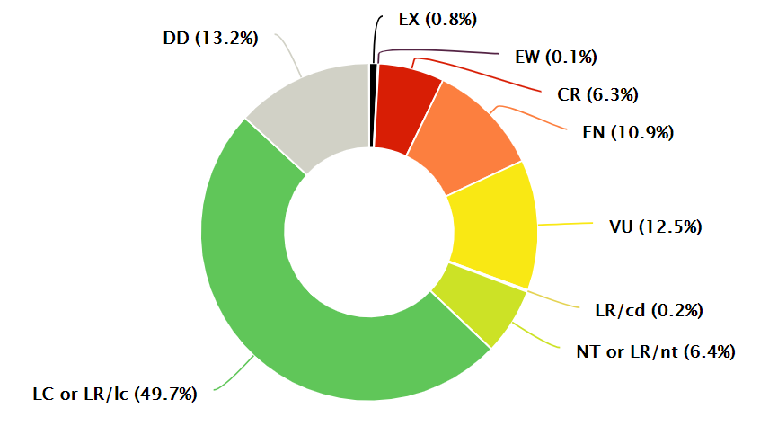
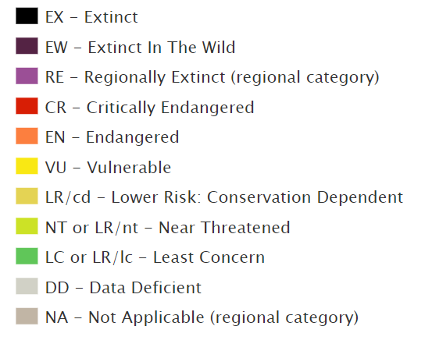
Declining Biodiversity Highlights Need to Accelerate Implementation of Conservation Initiatives
Terrestrial
Marine
Freshwater
IUCN RedList Endangerment Categories by System
Notes:
We can also look at patterns of species endangerment across systems to highlight research and conservation needs. For example, we know a lot about terrestrial ecosystems because we live here and its easy to study them, but its difficult to study species in freshwater and marine systems. We can’t wait around for these studies to be completed because more species might be gone before we can save them. So, accelerating the implementation of conservation initiatives is important in the short and long terms survival of species.

Slide 4
Biodiversity: Patterns AND Processes
Patterns
Processes
Primary production
Carbon cycling
Habitat use
Ecosystem services
Phenology
Vegetation dynamics
Hydrologic dynamics
Distribution
Abundance
Occupancy
Richness
Diversity
Rarity
Notes:
When we talk about conserving biodiversity it’s important to acknowledge that we need to conserve both patterns of biodiversity and the processes that sustain them.

Slide 5
Question 1:
What are some patterns and processes of biodiversity that you manage or study?
Post them in the chat!

Slide 6
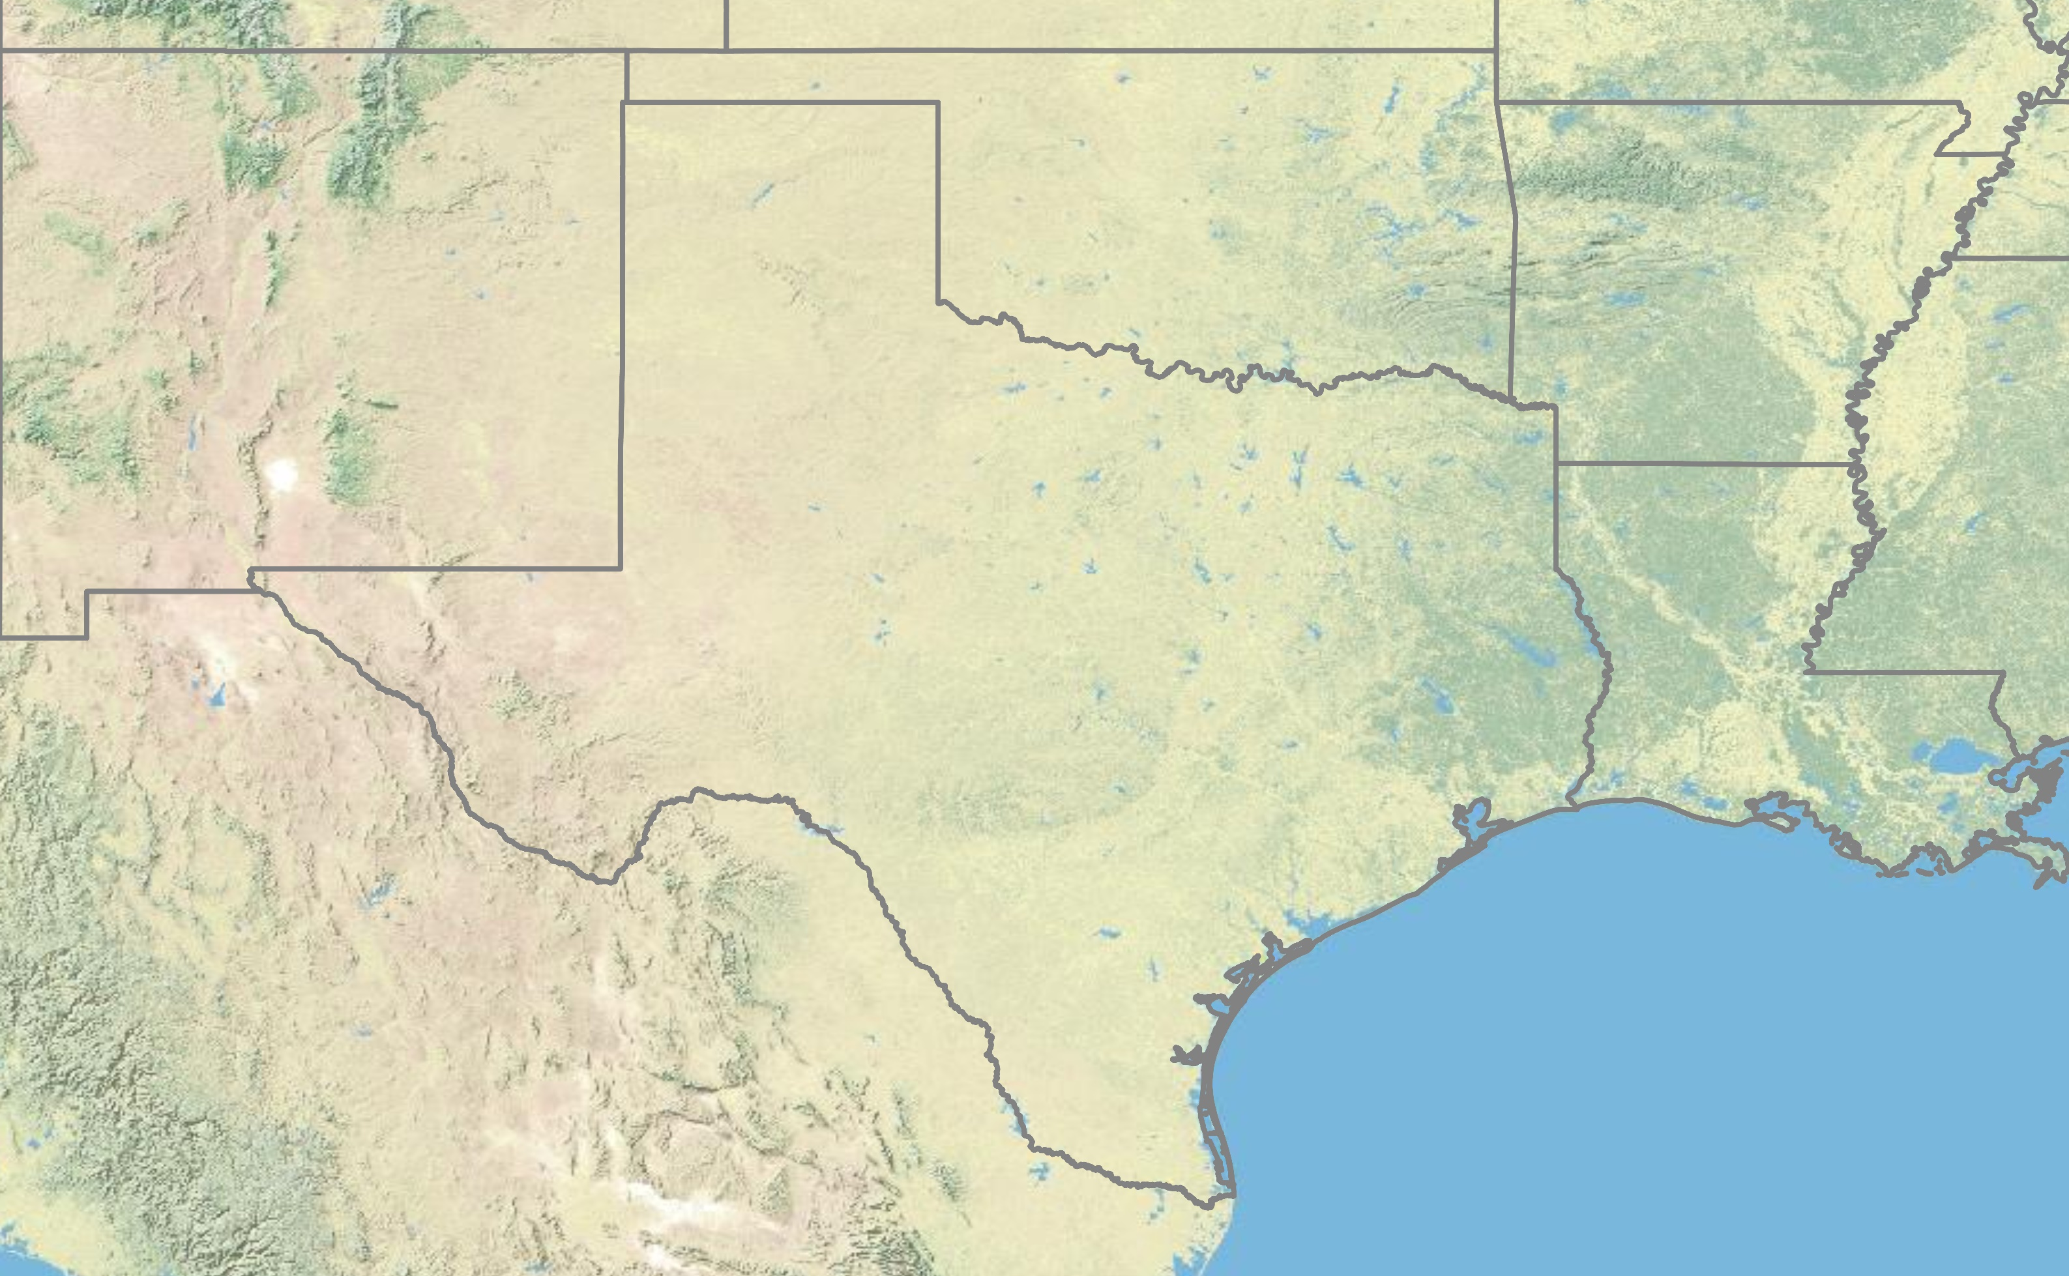
Conservation Prioritization: Where and how to act?
Decision makers/resource managers (you!) might face the difficult challenge of deciding where to allocate increasingly scarce resources for both human and environmental needs under increasingly challenging and uncertain future sociopolitical and environmental climates (how to)
Notes:
And so in our rapidly changing world in terms of climate, you might be….

Slide 7
Question 2:
What are some difficult resource allocation problems or tradeoffs that currently face or study, or anticipate in the future?
Post them in the chat!

Slide 8
Conservation Planning
Conservation Prioritization Stages
Scoping and costing the planning process
Identifying and involving stakeholders
Describing the context for the conservation initiative
Identifying conservation goals
Collecting data
Identify priority conservation areas
Setting conservation objectives
Research & Assessment Phase
Implementation Phase
Implementing conservation initiative in selected areas
Maintain and adaptively manage conservation initiative
Notes:
To conserve biodiversity, we often apply a conservation prioritization framework to guide decision making and funding regarding where to allocate resources. Maybe you’ve done something similar in your work or studies such as coming up with some sort of management plan. They can typically be broken down into two phases, research or assessment phase, and implementation phase.

Slide 9
Conservation Planning: The Implementation Crisis
Only 5.7% of conservation plans ever reached implementation!
Research
Implementation
Notes:
However, we face an implementation crisis in conservation because of a research- implementation gap. This study by knight et al. 2008 found that only 5.7% of conservation plans ever reached implementation!

Slide 10
The Implementation Crisis: Why?
Conservation initiatives fail to tackle problems from a social-ecological systems perspective
Failure to consider important sociopolitical factors
Complex tradeoffs between conservation outcomes and human needs
Failure to consider climate adaptation and resilience
Notes:
So why are we seeing this implementation crisis? Well mainly because conservation fails to tackle things from a social-ecological systems perspective. We often get so focused on protecting biodiversity that we fail to consider the tradeoffs between human needs and conservation outcomes that we recommend. We think of ourselves as separate from biodiversity when the problems we face are integrated. Planning frameworks often fail to consider climate adaptation and resilience as well.

Slide 11
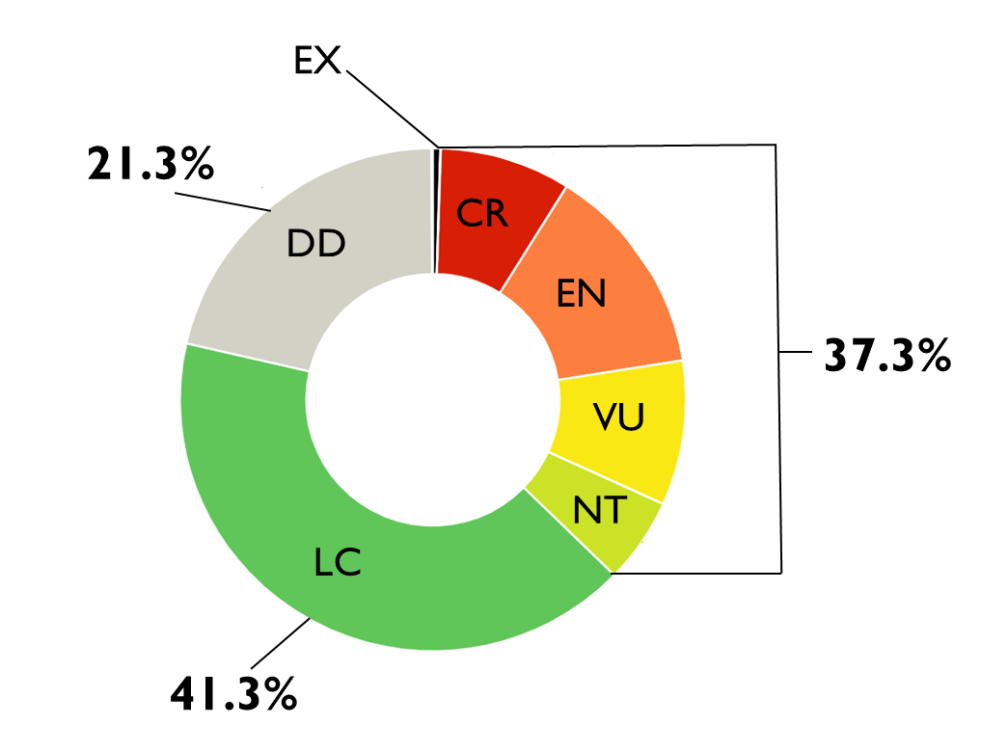
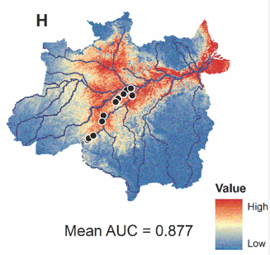
Prioritizations tend to only focus on the where to
Spatial Patterns (i.e., species distribution models)
Biodiversity Value
:Hayes et. al. 2018
Notes:
So, planning frameworks tend to only focus on the “where to” of biodiversity conservation, things like spatial patterns of biodiversity and the value associated with protecting those species.

Slide 12
Prioritizations fail to consider the how to
Conservation Feasibility: the sociopolitical factors that contribute to the likelihood of a conservation initiative being implemented and successful
Willingness to participate/sell
Socio-ecological value alignment
Socio-political/resource governance structures
Shared resource conflicts
Research
Implementation
Notes:
Prioritizations often fail to consider how to actually implement conservation initiatives. We argue that conservation planning needs to consider conservation feasibility in frameworks, or the….. These can be things like stakeholders willingness to….

Slide 13
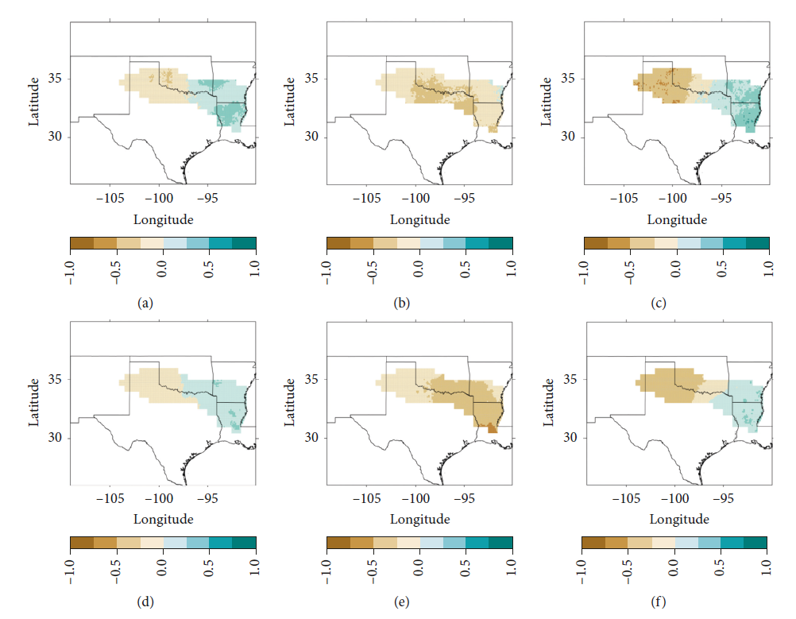
Prioritizations fail to consider future climate projections
Difference fields for mean daily precipitation (mm/day) between (1981-2005) and (2075-2099)
:Bertrand & McPherson 2019
Notes:
Climate change is also another significant challenge that planning frameworks tend to ignore. Patterns of biodiversity, the processes that sustain them, and the feasibility of implementing them will change over time, thus being inclusive of this uncertainty is important for planning.

Slide 14
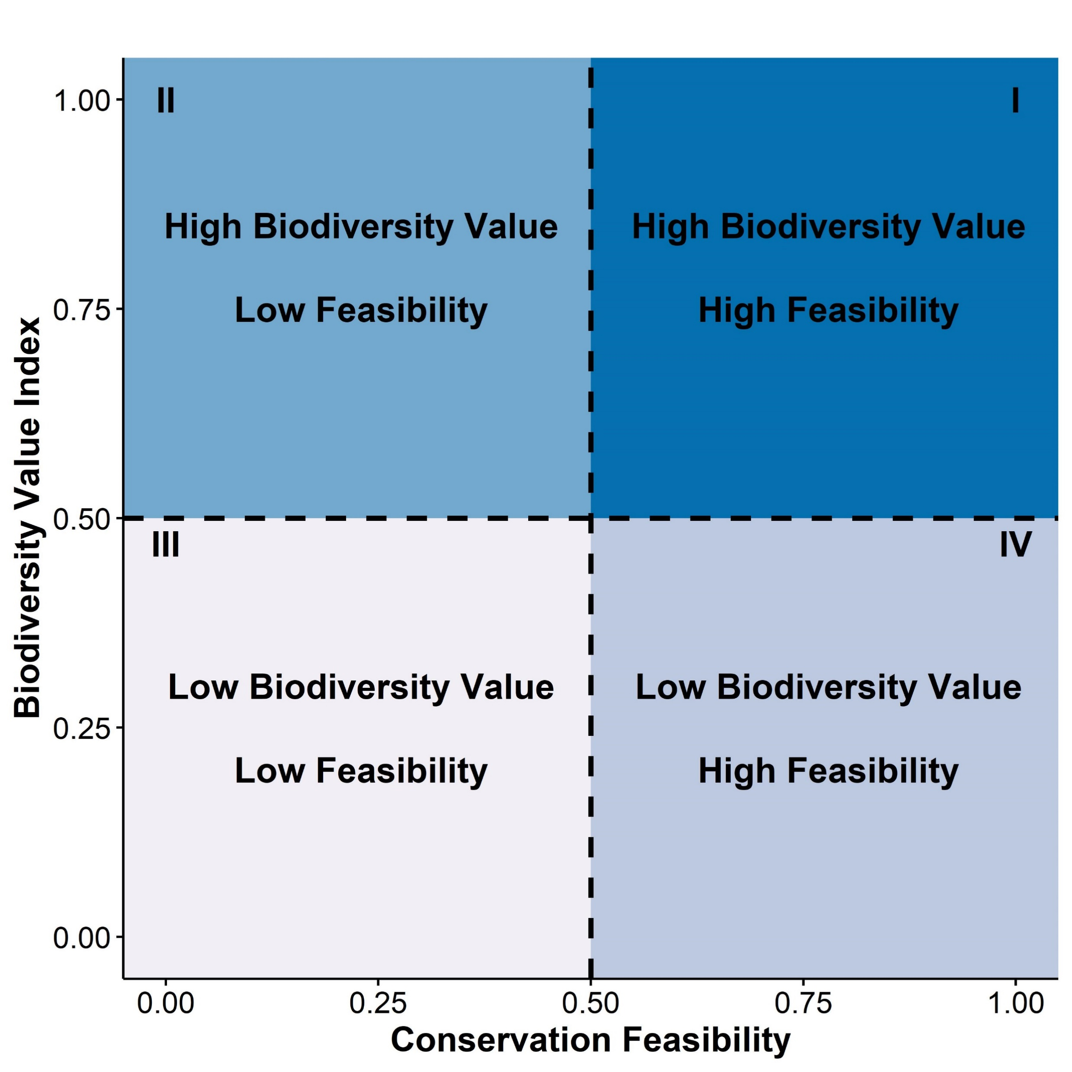
We developed a simple, flexible conservation prioritization framework
Significant Tradeoffs
High Priority/ Low Risk
Map the tradeoffs between biodiversity value (where to?) and conservation feasibility (how to?) across future climate scenarios
Integrates social and ecological data
Identifies key factors that contribute to conservation feasibility
Identifies site-level variation in conservation priority
Identifies sites resilient to climate change
Low Priority/ High Risk
Inefficient Outcomes
Notes:
So, taking all of that into consideration, we developed a simple, flexible conservation prioritization framework by mapping the tradeoffs between where to and how to implement conservation initiatives across future climate scenarios. This framework integrates social and ecological data…..
We simply plot some measure of biodiversity value and conservation feasibility and examine the tradeoffs using these quadrants as a guide. For example, the first quadrant up here represents sites that are high priority or low risk because they have high biodiversity value and feasibility. Sites that fall within this third quadrant represent low priority or high risk sites because theyre not really valuable or feasible to implement conservation initiatives at. The second quadrant up here represents sites with significant tradeoffs for biodiversity and human outcomes. Sites within this last quadrant down here represent sites with inefficient outcomes, we can conserve biodiversity here but our efforts might be worth more somewhere else.

Slide 15
Allow Biodiversity Value and Conservation Feasibility to Vary Independently Across Future Climate Scenarios
General Circulation Model (GCM)
CCSM4
MIROC5
MPI ESM LR
2.6
Representative Concentration Pathway (RCP)
4.5
8.5
Notes:
The climate aspect of this framework comes in here. We can quantify these factors across future climate scenarios, map them, and examine how the tradeoffs shift under different scenarios.

Slide 16
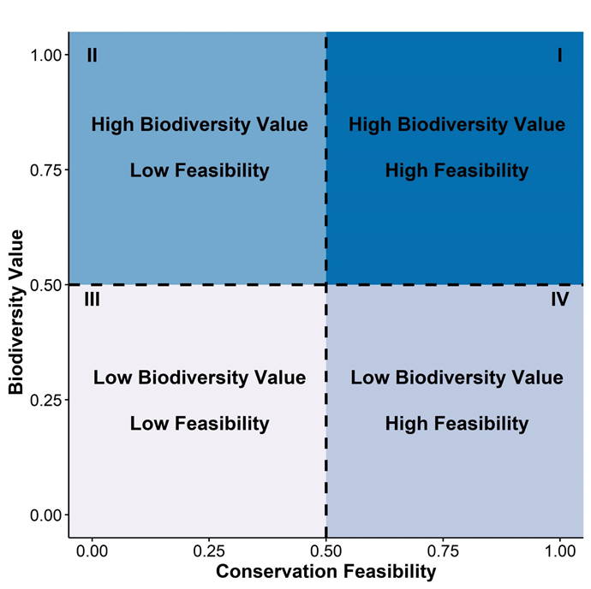
Biodiversity Value Applications
Example Applications:
Distribution, occupancy, abundance, etc. of species of interest
Ecosystem services provided by species
Habitat use or suitability
Risk of endangerment
Notes:
So actually measuring and quantifying these factors could be relatively simple and flexible as most conservation planners might have some of this data already. Things like the distribution…… Projecting this across future climate scenarios is something that you might be able to do quite easily with the abundance of free climate data out there.

Slide 17
Conservation Feasibility Applications
Example Applications:
Stakeholder or landowner’s willingness to participate in conservation initiative
Stakeholder or landowner’s willingness to sell land or water rights
Identifying sociopolitical barriers to implementation
Identifying if public values align with ecological values
Likelihood of a policy or program to be implemented
Tradeoffs between shared resources
Notes:
Quantifying and measuring conservation feasibility could involve collecting data like…..
Projecting this data across future climate scenarios might be more difficult if its mores social-oriented, but if you have some measures of resource availability like funding or water or something that can be projected. Social aspects could be held constant across future climate scenarios.

Slide 18
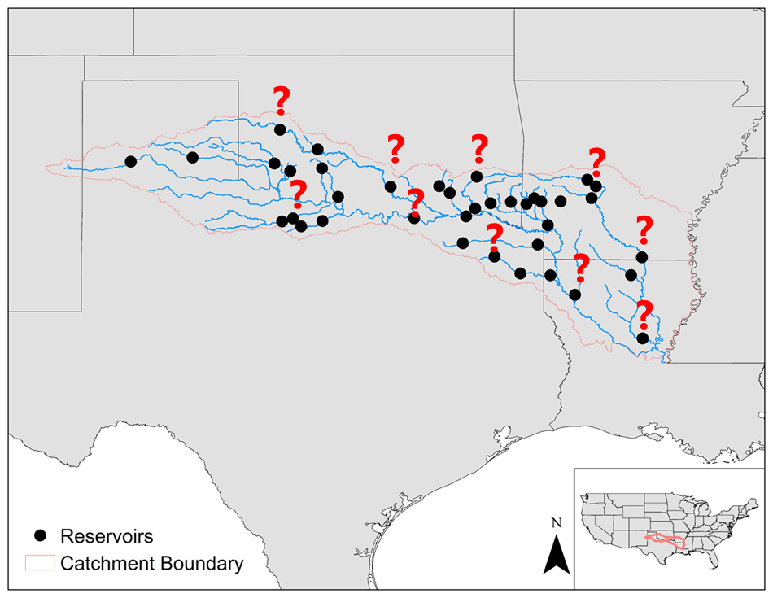
Case Study
Research Questions:
Is our prioritization framework effective at identifying site-level variation in conservation priorities?
Is our prioritization framework effective at identifying sites resilient to climate change?
Application: Where is it most feasible and valuable to implement environmental flows in the Red River basin?
Notes:
So, to highlight the use of this framework we applied it to the challenge of implementing environmental flows in the red river basin.

Slide 19
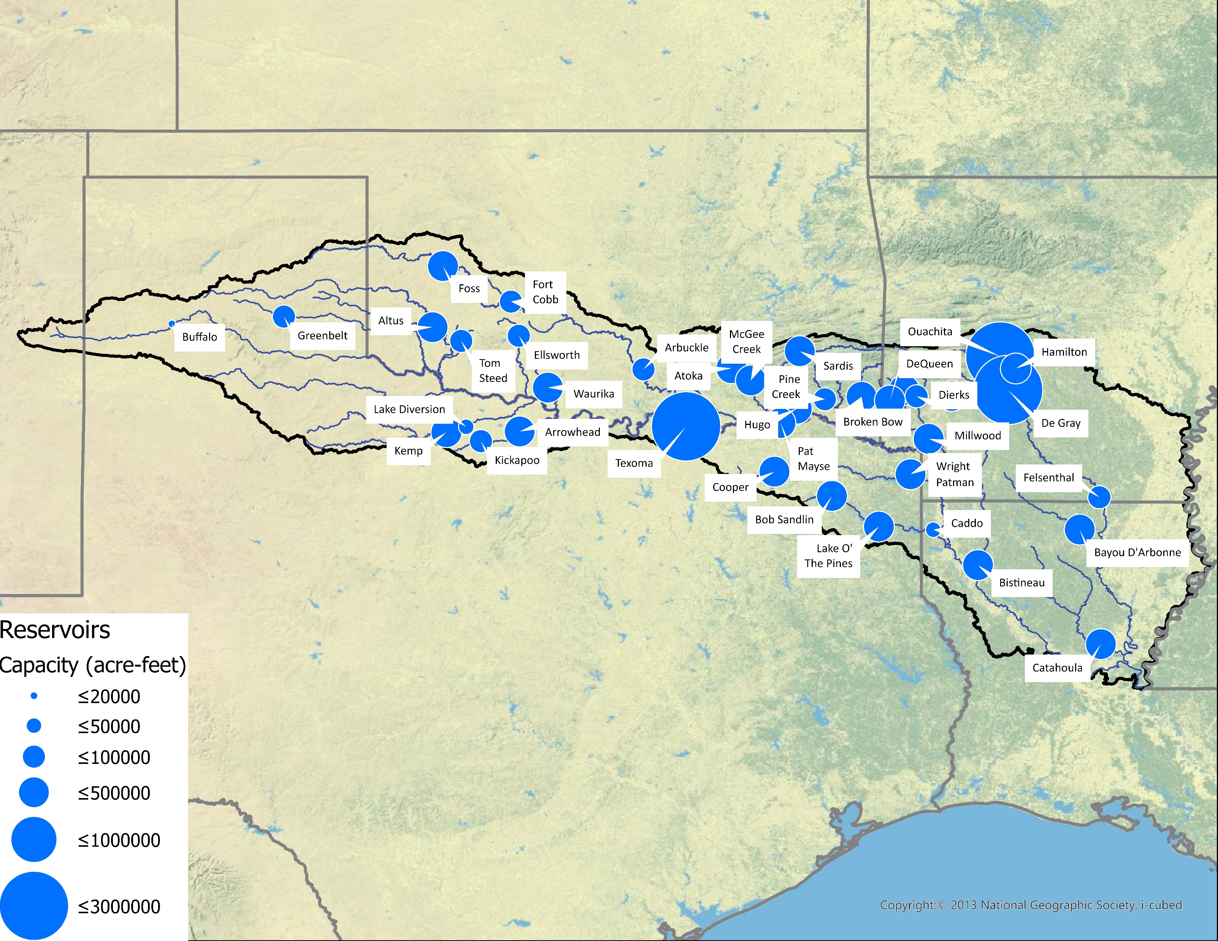
Study Region: 38 major reservoirs

Slide 20
Environmental Flows: What are they?
Water for freshwater ecosystems and the human livelihoods that depend on them
Societal Water
(Sustain Municipal and Agricultural Needs)
Environmental Flows
(Sustain Ecosystem and Human Livelihood/ Recreational Needs)
:WWF
Notes:
I’m going to be mainly focusing on freshwater ecosystems in this talk, and one of the key natural resource management features of freshwater systems is environmental flows. So what are environmental flows? In the simplest form, e-flows can be defined as water for freshwater ecosystems….
In an ideal management scenario, water within reservoirs is pumped out to sustain municipal and agricultural needs, and some might be let downstream to sustain to sustain ecosystem and human needs that might include fishing or recreation

Slide 21
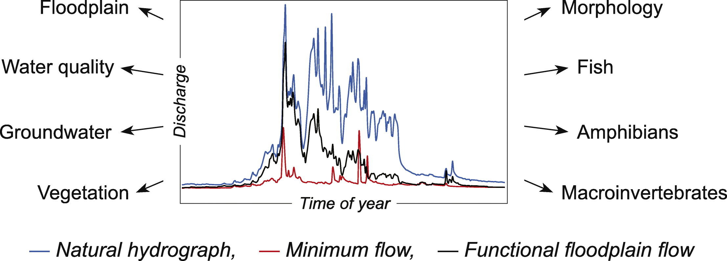
Environmental Flows: What do they do?
Mitigate adverse impacts from water diversion and storage
“Mimic” the natural flow regime – quantity, timing, quality of river flows
Essential for riverine & floodplain ecosystem structure and function
:Hayes et. al. 2018
Notes:
Environmental flows are a water management paradigm that attempt to mimic the natural flow regime of rivers in term of the quantity, timing, and quality of river flows.
So, if we look at what a typical river flow regime might look like without any hydrological modifications (blue line), we can see two different environmental flow regimes (red and black) lines that attempt to mimic or restore some aspect of that lost natural regime

Slide 22
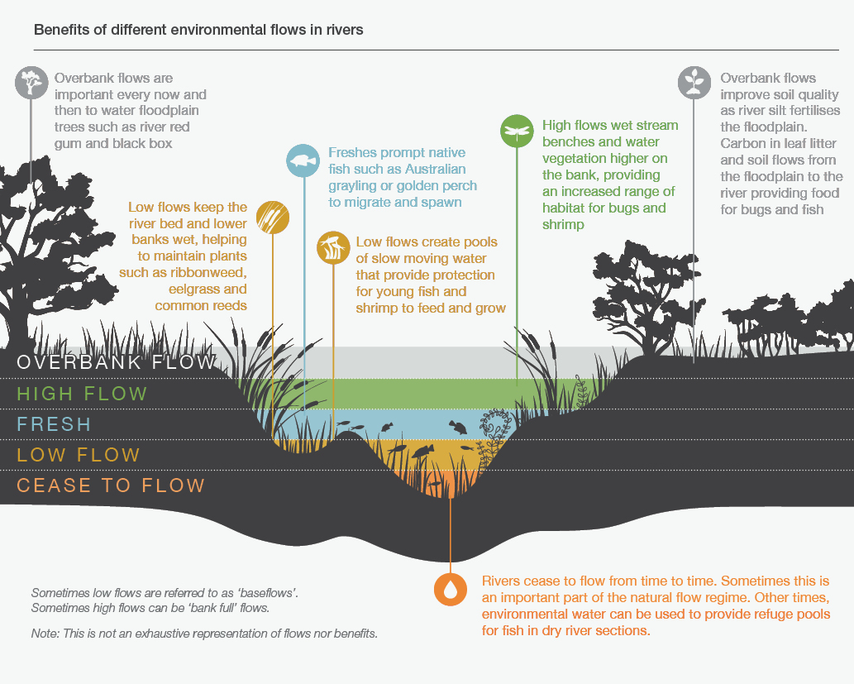
Environmental Flows: Types and Benefits
:VEWH
Notes:
There are many different types of environmental flows that can be categorized by their severity and function, as well as many benefits. For example, occasional overbank flows can sustain floodplain vegetation and provide habitat for insects.

Slide 23
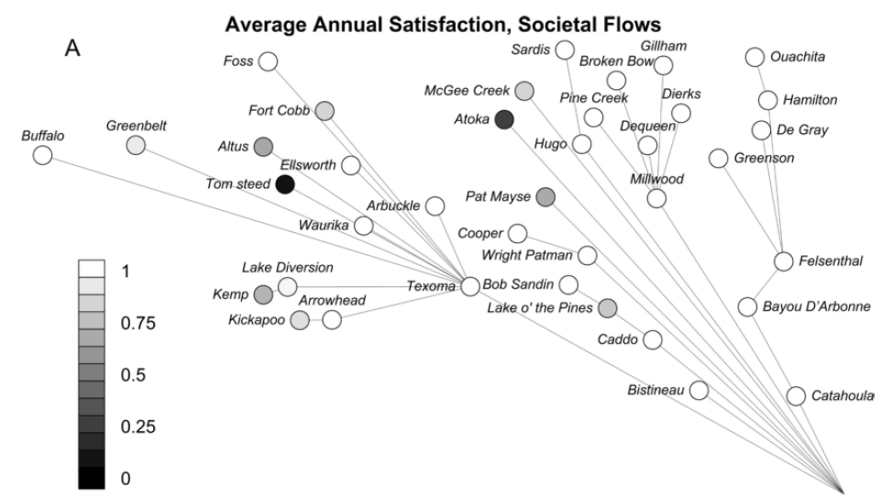
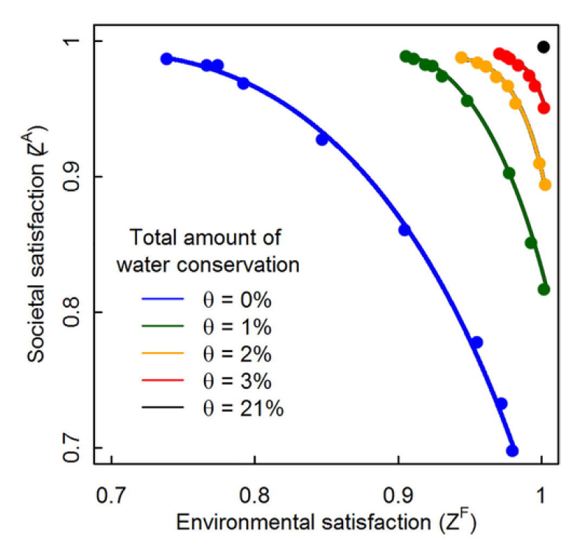
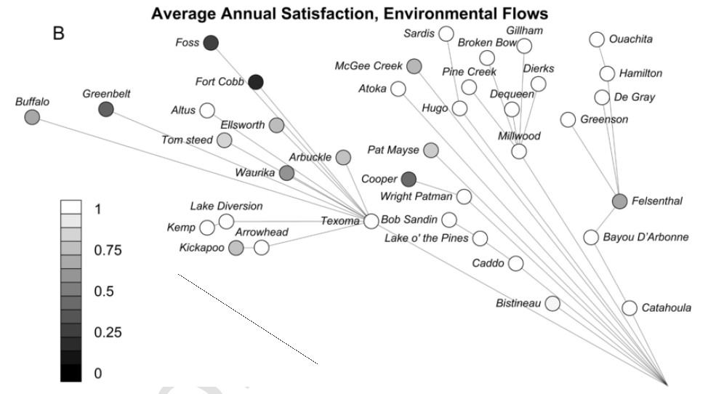
Challenge: Current Water Availability Insufficient for Competing Needs
Satisfied
Unsatisfied
Satisfied
Unsatisfied
:Zamani-Sabzi et al. 2019

Slide 24
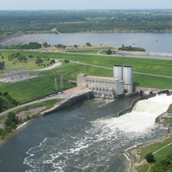
Application: Meeting Environmental Flow Targets (Conservation Feasibility)
: Zamani-Sabzi et al. 2019, David Norris

Slide 25
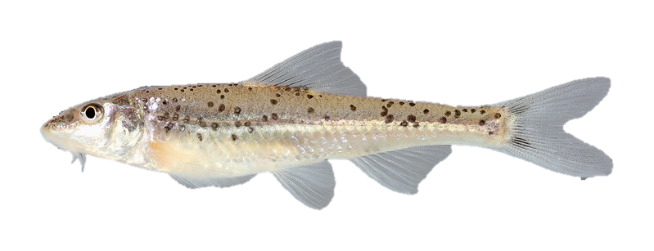
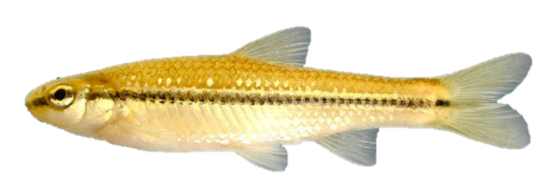
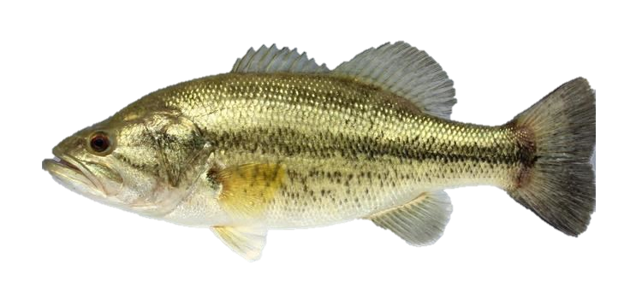
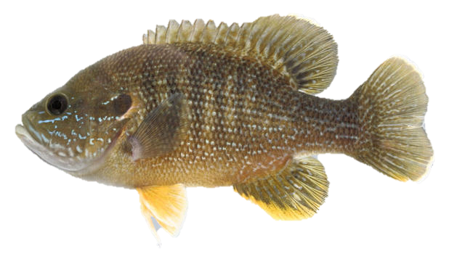
Environmental Flows for Biodiversity Conservation
Blackspot Shiner (Notropis atrocaudalis)
IUCN: Least Concern
Oklahoma: Tier I (Top Priority)
Prairie Chub (Macrhybopsis australis)
IUCN: Vulnerable
Oklahoma: Tier I (Top Priority)
Biodiversity Value
Green Sunfish (Lepomis cyanellus)
IUCN: Least Concern
Oklahoma: Not ranked (Low Priority)
Spotted Bass (Micropterus punctulatus)
IUCN: Least Concern
Oklahoma: Not ranked (Low Priority)
:Uland Thomas
Notes:
For my research, I focus on environmental flows for biodiversity conservation, mainly fish, but environmental flows that benefit fish will also act as an umbrella management strategy and also provide benefits to other aquatic life. For example we can consider fish species present in specific areas as having a range of biodiversity value based on their conservation status rankings from various state and international entities.

Slide 26
Biodiversity Value Index

Slide 27
Fish Species Considered
Ameiurus melas | Black bullhead
Cyprinella lutrensis | Red shiner
Cyprinodon rubrofluviatilis | Red River pupfish
Etheostoma collettei | Creole darter
Etheostoma radiosum | Orangebelly darter
Fundulus zebrinus | Plains killifish
Gambusia affinis | Western mosquitofish
Hybognathus placitus | Plains minnow
Ictalurus furcatus | Blue catfish
Lepomis cyanellus | Green sunfish
Lythrurus snelsoni | Ouachita shiner
Macrhybopsis australis | Prairie chub
Macrhybopsis hyostoma | Shoal chub
Macrhybopsis storeriana | Silver chub
Micropterus dolomieu | Smallmouth bass
Micropterus punctulatus | Spotted bass
Micropterus salmoides | Largemouth bass
Morone saxatilis | Striped bass
Notropis atherinoides | Emerald shiner
Notropis atrocaudalis | Blackspot shiner
Notropis bairdi | Red River shiner
Notropis boops | Bigeye shiner
Notropis ortenburgeri | Kiamichi shiner
Notropis perpallidus | Peppered shiner
Notropis potteri | Chub shiner
Notropis stramineus | Sand shiner
Notropis suttkusi | Rocky shiner
Percina copelandi | Channel darter
Percina pantherina | Leopard darter
Phenacobius mirabilis | Suckermouth minnow
Pteronotropis hubbsi | Bluehead shiner

Slide 28
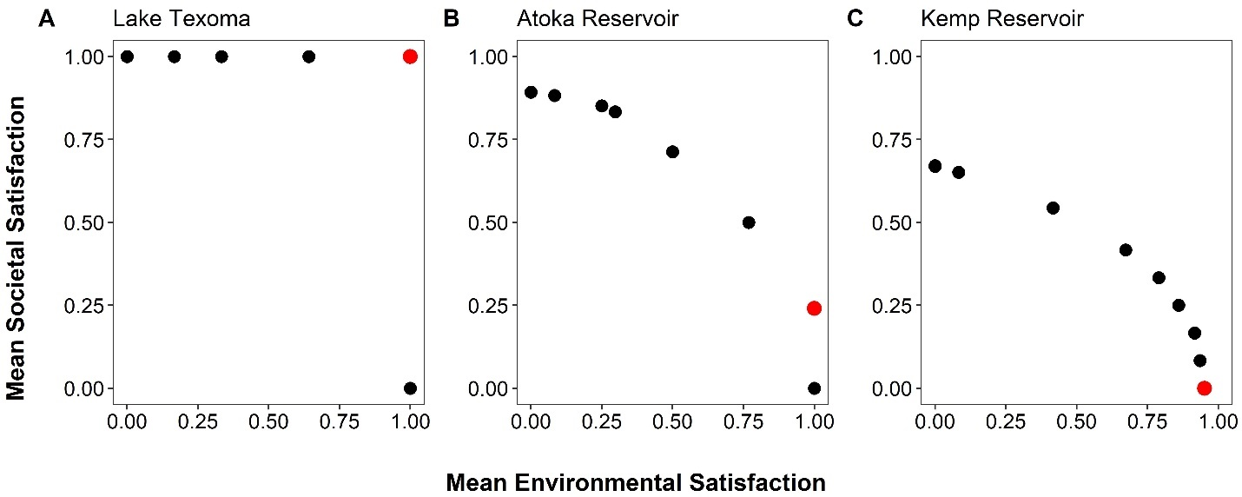
Conservation Feasibility: Sociopolitical Resistance to E-flows

Slide 29
Results: Site Variation Across Future Climate Scenarios

Slide 30
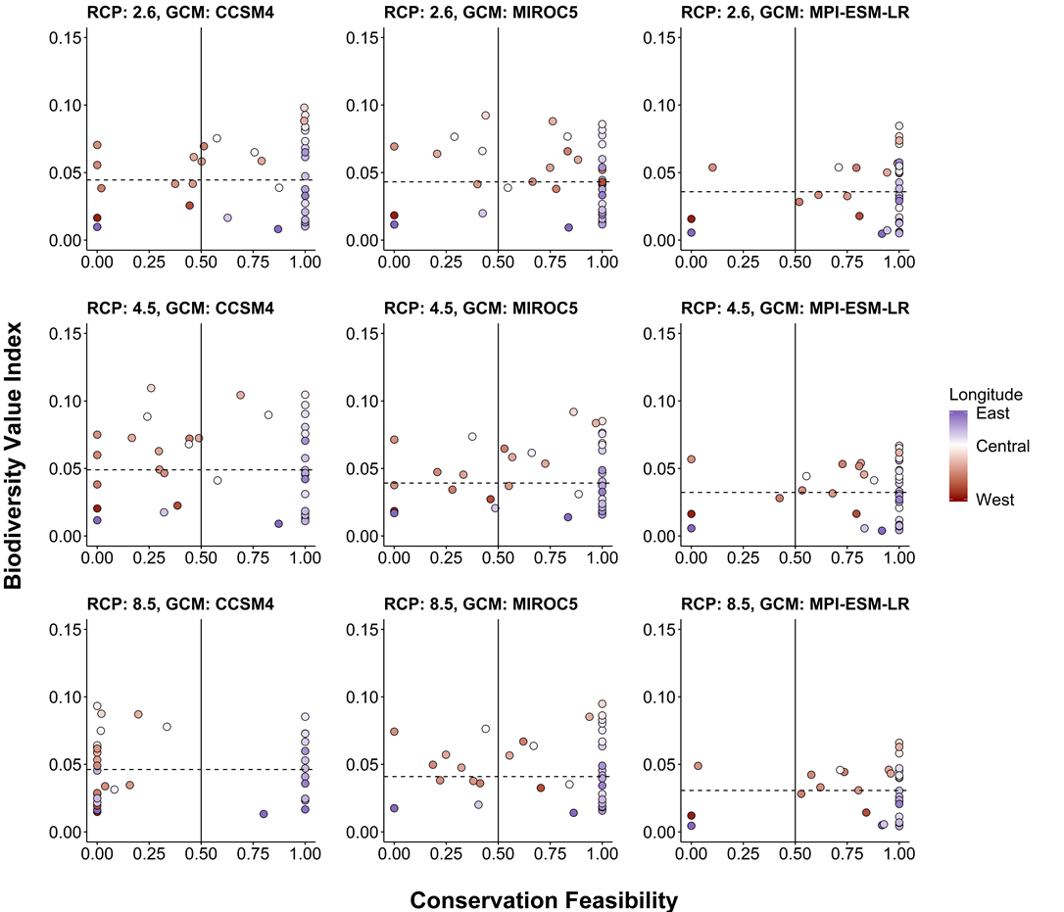
Results: Site Variation Across Future Climate Scenarios

Slide 31
Results: Site Variation Across Future Climate Scenarios

Slide 32
Results: Site Variation Across Future Climate Scenarios

Slide 33
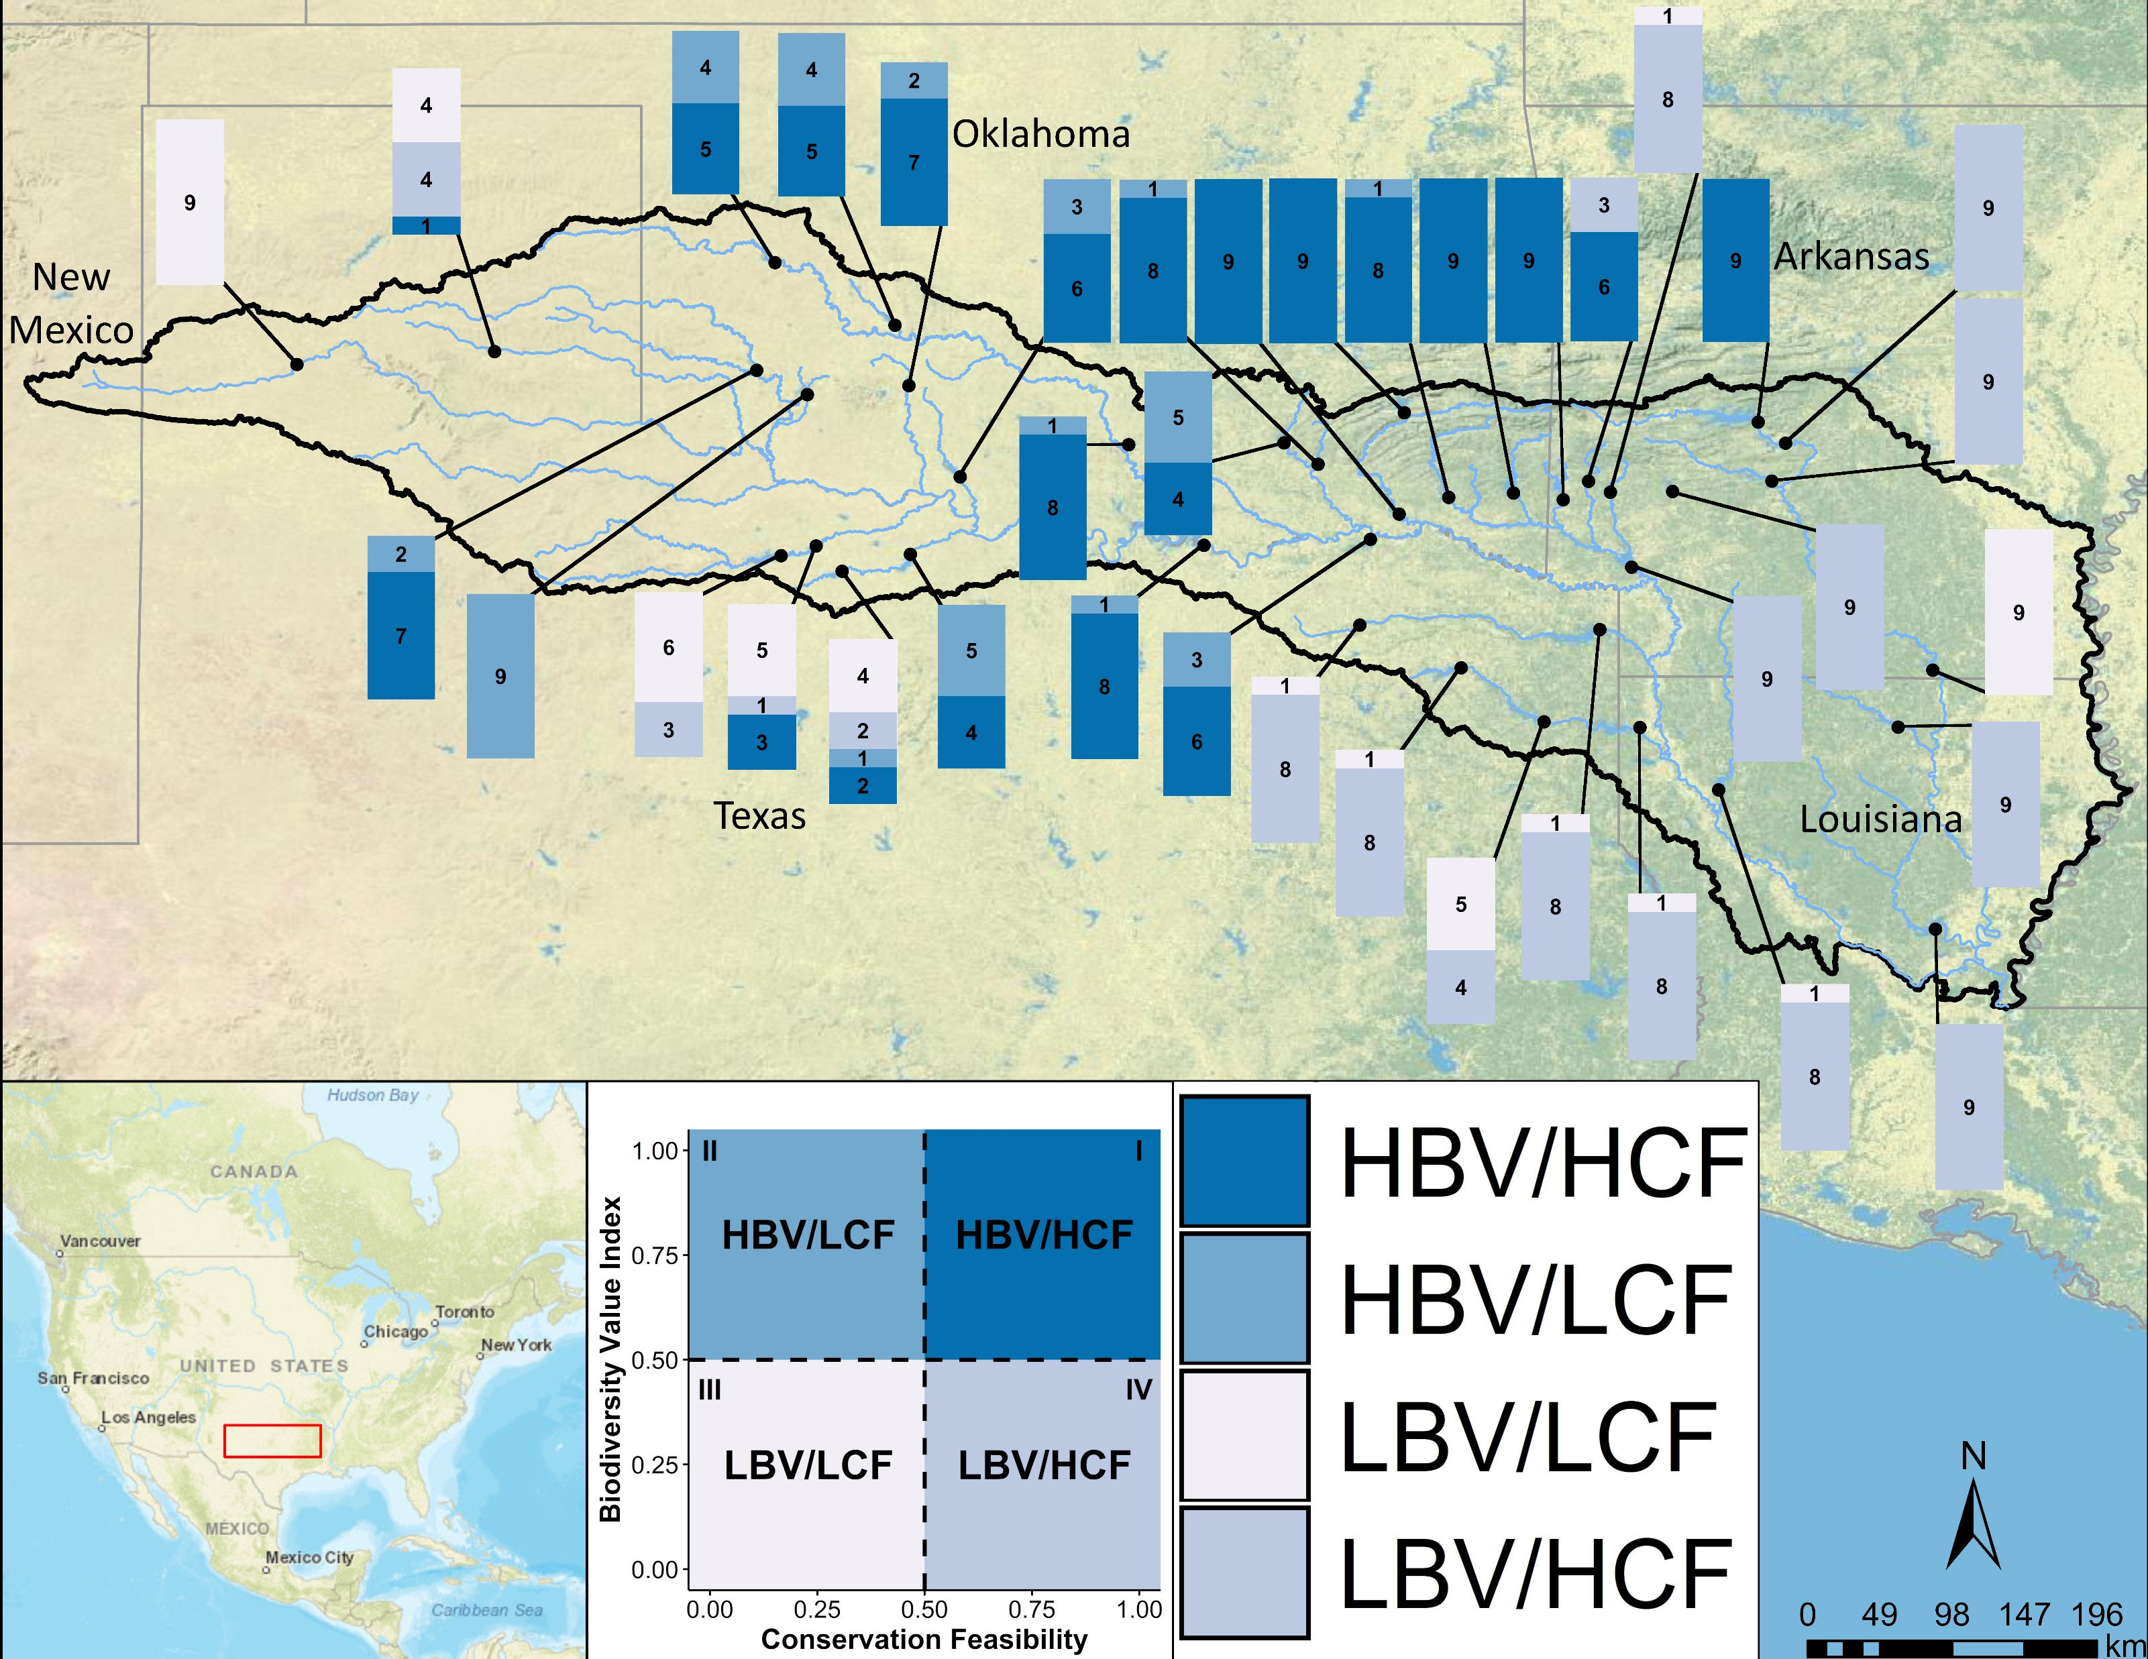
Where are outcomes consistent across future climate scenarios?

Slide 34
Where are outcomes consistent across future climate scenarios?

Slide 35
High uncertainty in arid western reaches

Slide 36
High Feasibility, Low Biodiversity Value in Eastern Reaches (Why Not?)

Slide 37
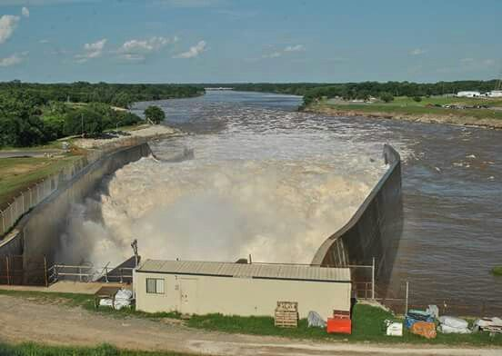
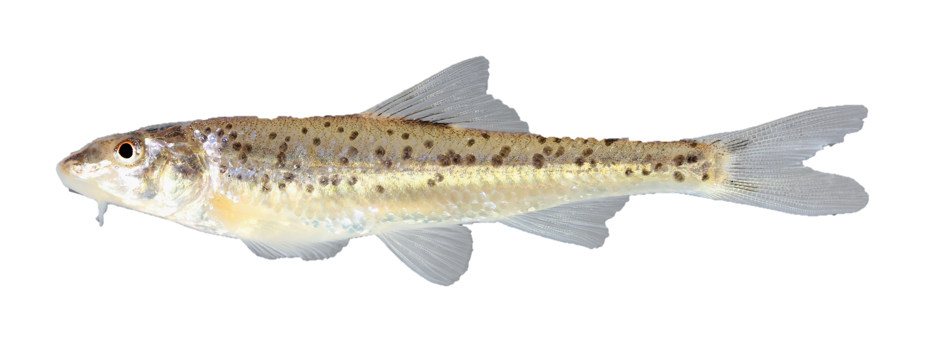
Implications
Coarse-scale tool/framework for identifying high priority climate resilient sites to implement environmental flows
Use to winnow candidate sites
Many other factors to consider, but this tool can be used in early stages of planning
Prairie Chub (Macrhybopsis australis)
:Uland Thomas, Ricky Porter

Slide 38
Question 3
Can you think of a potential application for this prioritization framework that would be relevant for examining tradeoffs with the resources you manage or study?
Post them in the chat below!
Notes:
As natural resource managers, can you think of any benefits that e-flows could provide?

Slide 39
Acknowledgements
Tom Neeson (OU)
Rachel Fovargue (OU)
Abigail Lynch (USGS)
Craig Paukert (USGS)
Betsey York (ODWC)
Dan Allen (OU)
Caryn Vaughn (OU)
Funding:
Science to Action Fellowship
National Climate Adaptation Science Center, USGS

