Slide 1
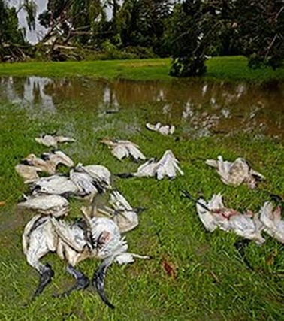
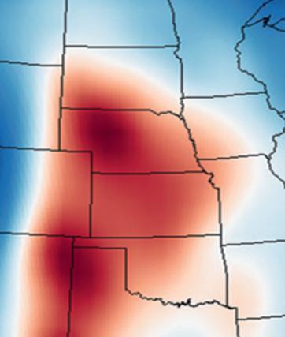
Climate Change and Ecological Impacts
Jeremy D. Ross
Oklahoma Biological Survey
University of Oklahoma
severeweatherecology.oucreate.com

Slide 2

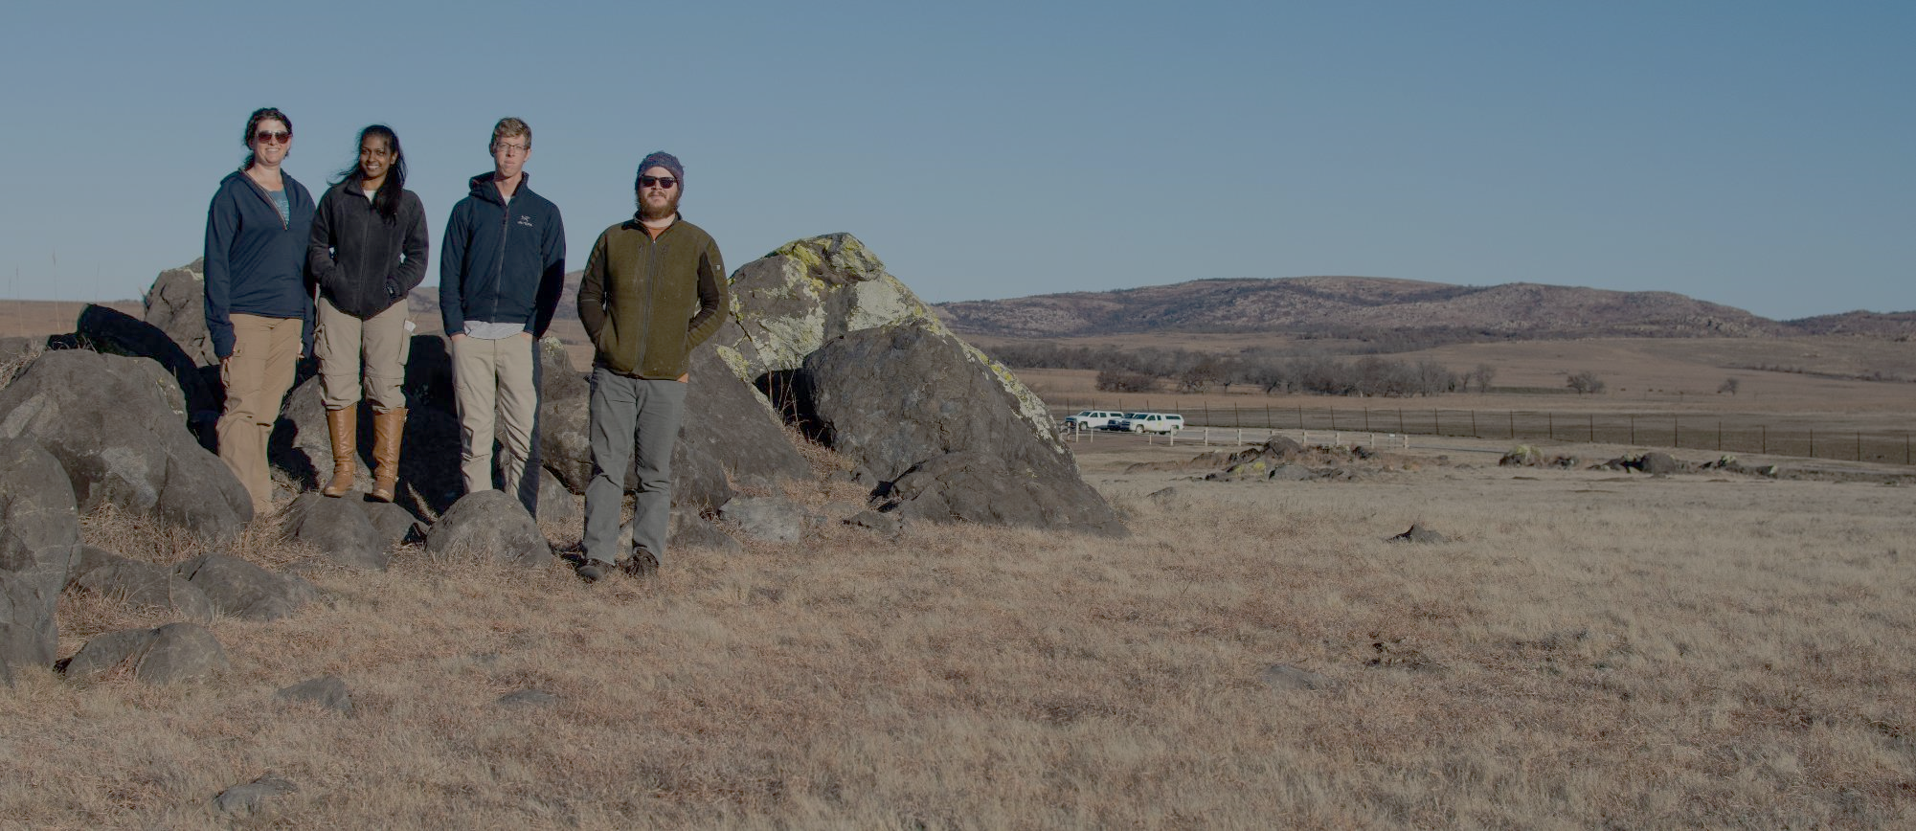



Collaborators & Grad Students
Technicians & Volunteers
Paula Cimprich
Joe Grzybowski
Krisangel Lopez
Randy Soto
Alex Cooper
Meelyn Pandit
Elizabeth Bessozi
Eli Bridge
Jeff Kelly
Alice Boyle
John Neill
Amber Carver
Mike Wunder
John Muller
Nu Perera
Meelyn Pandit
Israel Lugo
Richard Rodriguez
Mary Emanuel
Daniel Horton
Ivy Ciaburri
Fabiola Baeza-Tarin
Funding
ODWC State Wildlife Grant
National Fish and Wildlife Foundation – ConocoPhillips SPIRIT of Conservation Grant
NSF - National Research Trainee Fellowship
Nature Conservancy Nebraska J. E. Weaver Grant
George Miksch Sutton Scholarship (OU)
Wilson Ornithological Society Paul A. Stewart Grants
OU Graduate Student Senate Research Grants
Oklahoma Ornithological Society

Slide 3
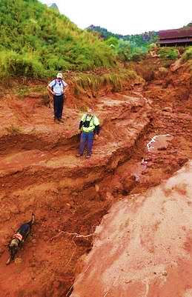
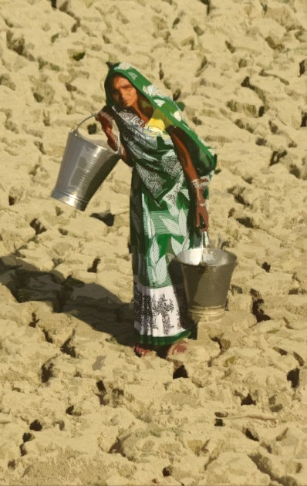
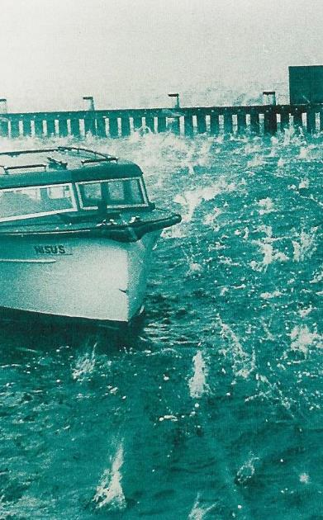
Severe Weather
Transient climate extremes linked to wider atmospheric processes

Slide 4
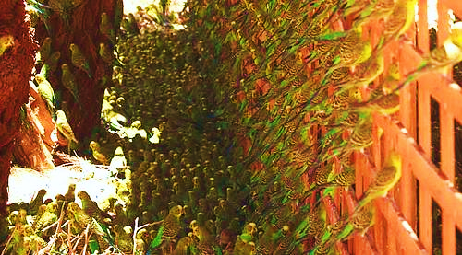
Weather Effects on Populations
Comfort
Tolerance
B. Strick

Slide 5
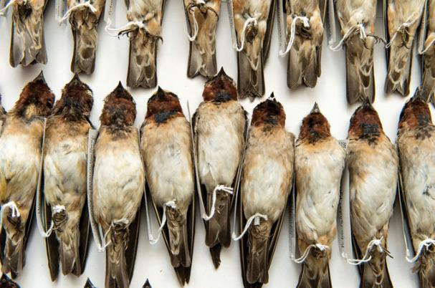
Weather Effects on Populations
Comfort
Tolerance
Selection
University of Tulsa
Brown & Brown (1998, 2000)

Slide 6
Weather Effects on Populations
Unidirectional impacts:
Hailstorms
Hurricanes
Ice Storm
Comfort
Tolerance
Selection
Catastrophe
Bi-directional conditions:
Temperature
Precipitation
Notes:
Population limitations possibly incurred by frequent and severe enough weather

Slide 7
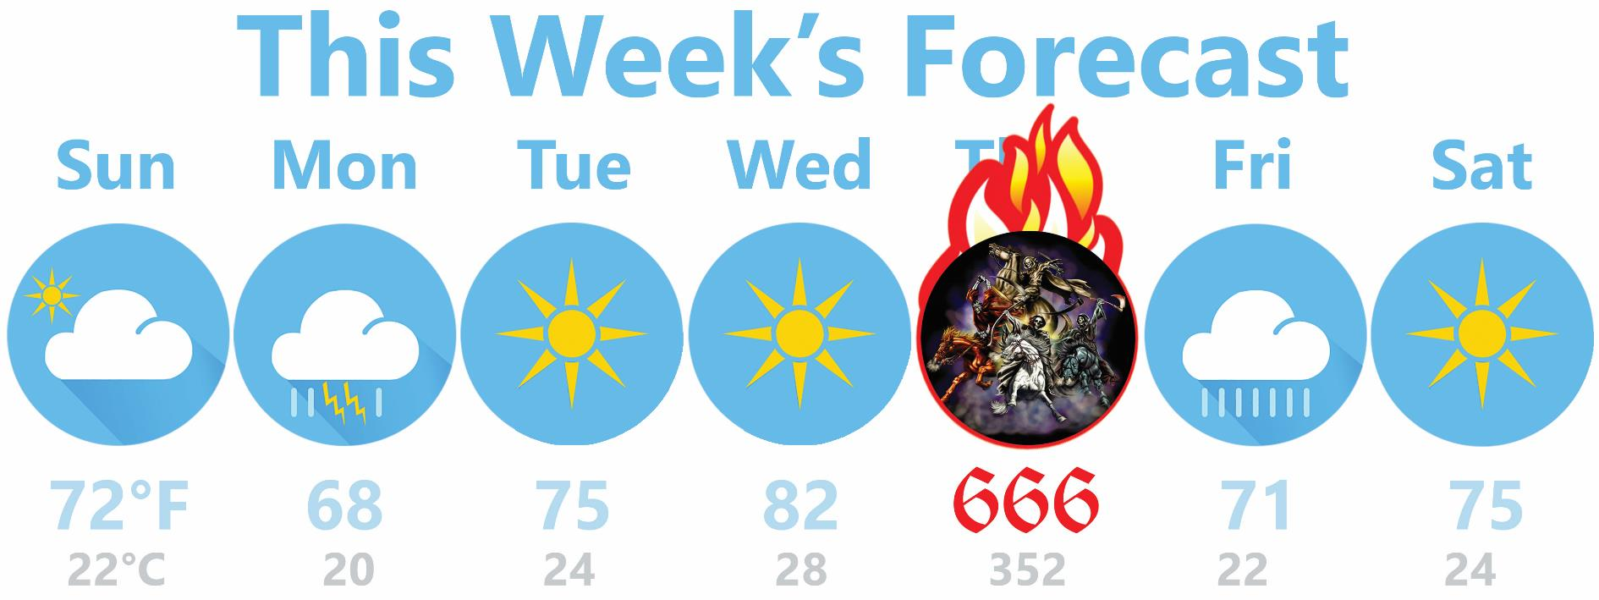
Catastrophes are game-changers

Slide 8
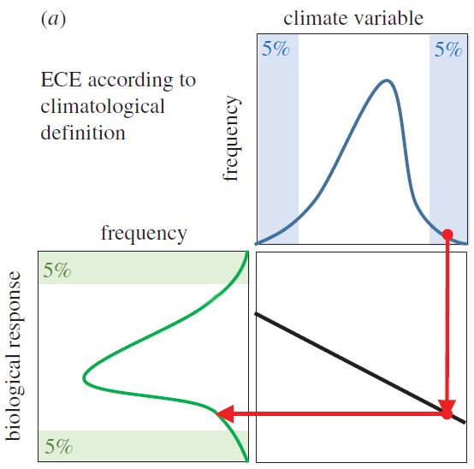

What is an extreme climatic event (ECE)?

Slide 9
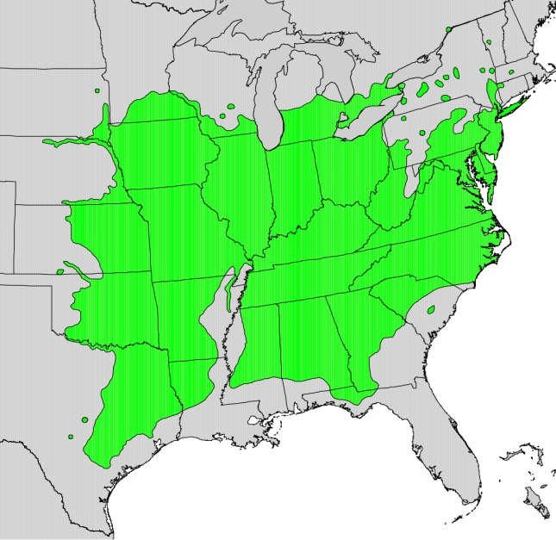
Defining “extreme” climatologically
Different Regional Climates
Notes:
Population limitations possibly incurred by frequent and severe enough weather

Slide 10
Defining “extreme” by Impact
Different Regional Histories
Notes:
Population limitations possibly incurred by frequent and severe enough weather

Slide 11
Understanding Severe Weather Ecology Impacts
How do we study such locally-unpredictable and transient events?
What can managers do to prevent and mitigate impacts?

Slide 12
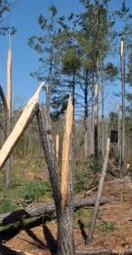
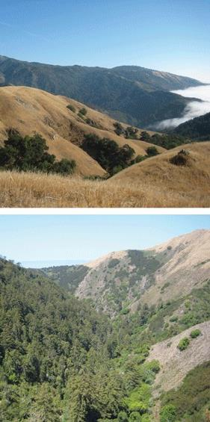
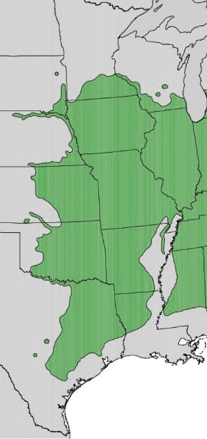
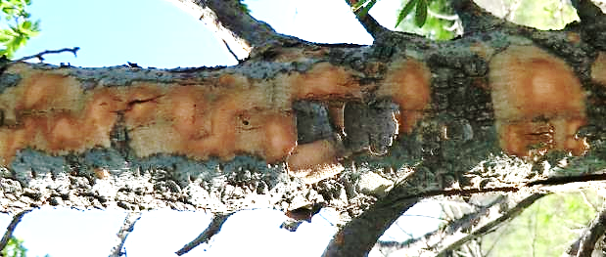
Weather Ecology at Scales
How do patterns of climate relate to patterns of impact?

Slide 13
Weather Ecology at Scales
Spatial
Temporal
Interact with landscape & habitat variables
  Non-linear thresholds
Feedback with vegetation
Connectivity impacts
Mechanistic
  Limit species & habitat occupancy
Non-independence of events (severity of impact depends upon prior events)
Dynamic

Slide 14
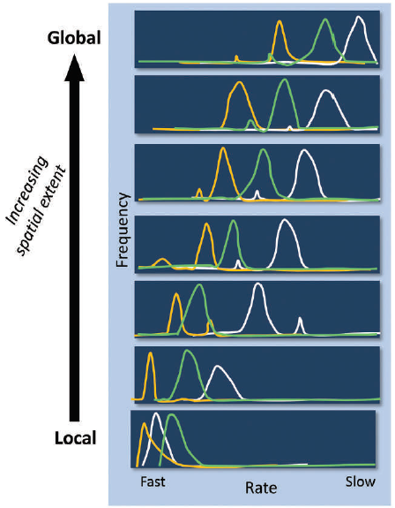

Heffernan et al. 2014. Frontiers in Ecology and the Environment 12:5-14
Vegetation Climate Mammals

Slide 15
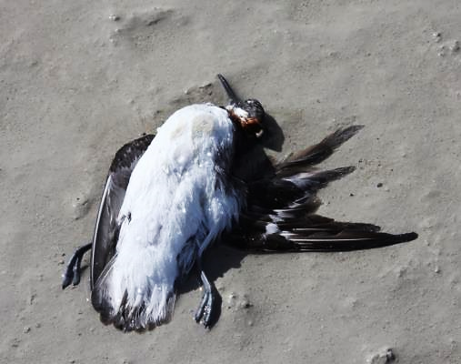
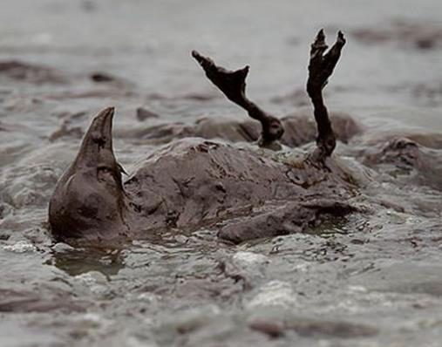
Attributing Impacts at Short & Local Scales
disaster
Studies of weather impacts limited by:
  After-the-fact data collection
  Site access constraints
  Unreplicable
  Confounding covariates (e.g., debris, scavenging)
  Non-randomization
  Risks of pseudoreplication
J. Neill
Mirror.co.uk

Slide 16
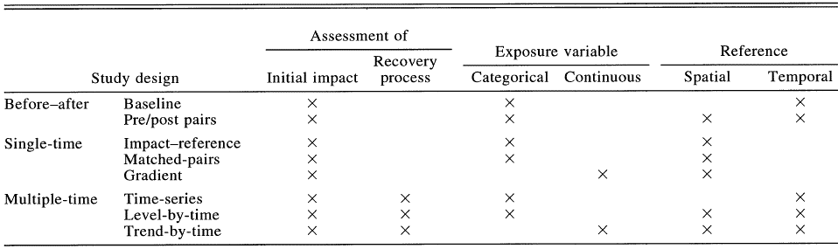
Accidental Ecological Impacts: Methodological Approaches
3 major approaches
  Subcategories of increasing complexity
Notes:
Before-after-control-impact

Slide 17
Post-event Methods Flowchart
Feasible to revisit multiple times?
Yes
Affect existing study site?
Yes
Before-After
No
No
Comparable Sites?
Single-time Study
Multi-time Study
Yes
No
Pre/post Pairs
Continuous
Categorical
Continuous
Categorical
Baseline
Trend-by-time
Relatively Shorter
Recovery w/ natural disasters
Gradient
Comparable Sites?
Comparable Sites?
No
Yes
No
Yes
Impact-Reference
Matched Pairs
Time Series
Impact Level Over Time

Slide 18
Post-event Methods Flowchart
Feasible to revisit multiple times?
Yes
Affect existing study site?
Yes
Before-After
No
No
Comparable Sites?
Single-time Study
Multi-time Study
Yes
No
Pre/post Pairs
Continuous
Categorical
Continuous
Categorical
Baseline
Trend-by-time
Gradient
Comparable Sites?
Comparable Sites?
No
Yes
No
Yes
Covariates
Impact Level Over Time
Impact-Reference
Matched Pairs
Time Series

Slide 19
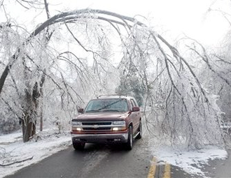
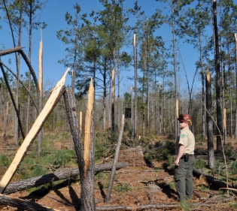
Individual Effects of Severe Weather
Tree form
taper
density
crown shape
rooting depth
Taper = 90% 70% 40%
Courtesy of H. McCarthy
Flexibility vs. strength

Slide 20
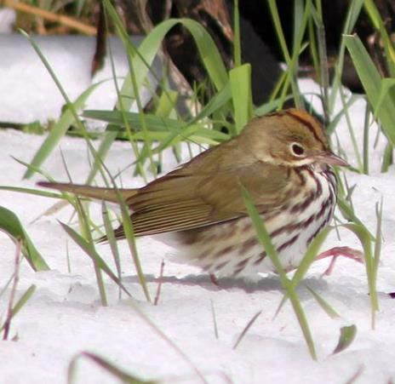
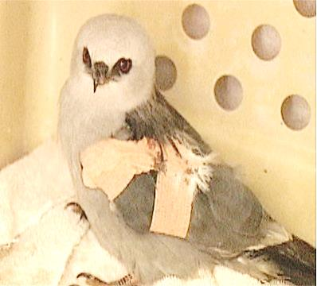
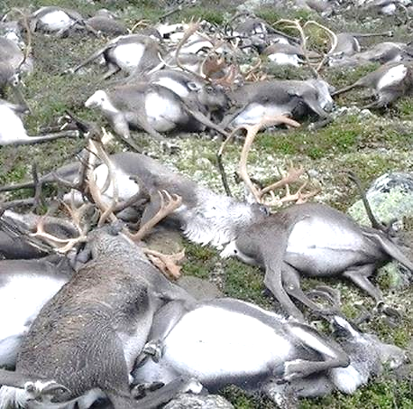
Individual Effects of Severe Weather
Post-event reports of animals …
  Taxed
  Injured
  Lost nests
  Killed
C.Trembath
KFOR
Notes:
Impacts in birds more fleeting, harder to detect, and less quantifiable. However, still an important ecological consideration.

Slide 21
Severe Weather Exposure
Can occur throughout life-cycle
Potentially high-risk periods
  Nesting
    e.g., hailstorm impacts on grassland birds

Slide 22
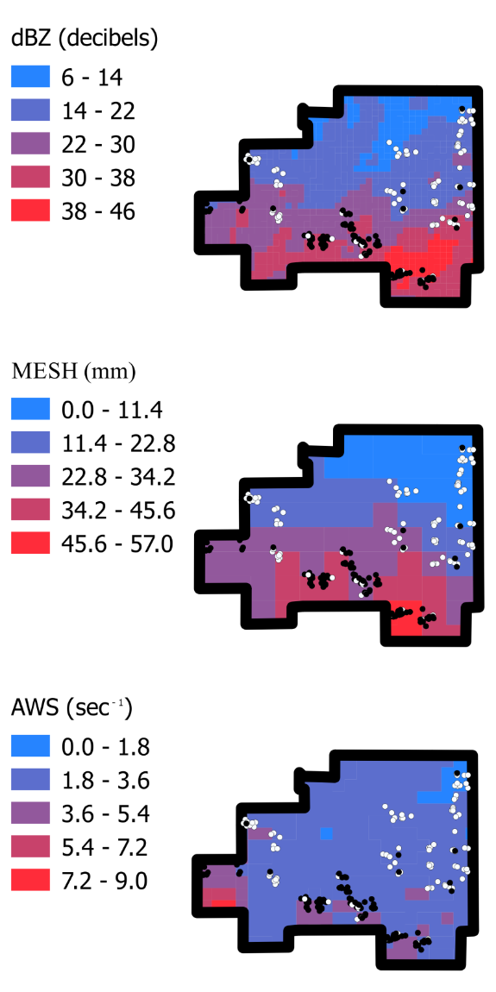
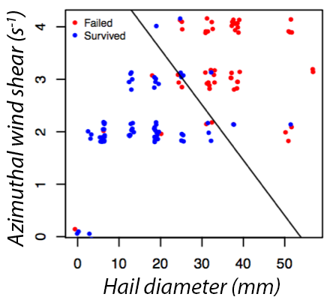
High Plains Hailstorm 6/22/14
Carver et al. (in prep)

Slide 23
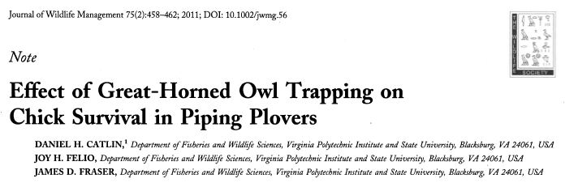
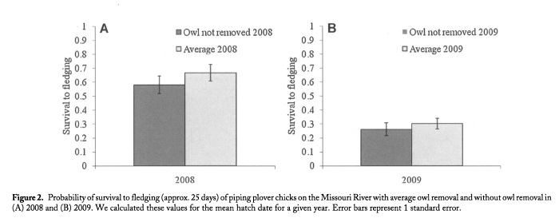


Slide 24
Severe Weather Exposure
Can occur throughout life-cycle
Potentially high-risk periods
  Nesting
  Molting
  Migratory stopover

Slide 25
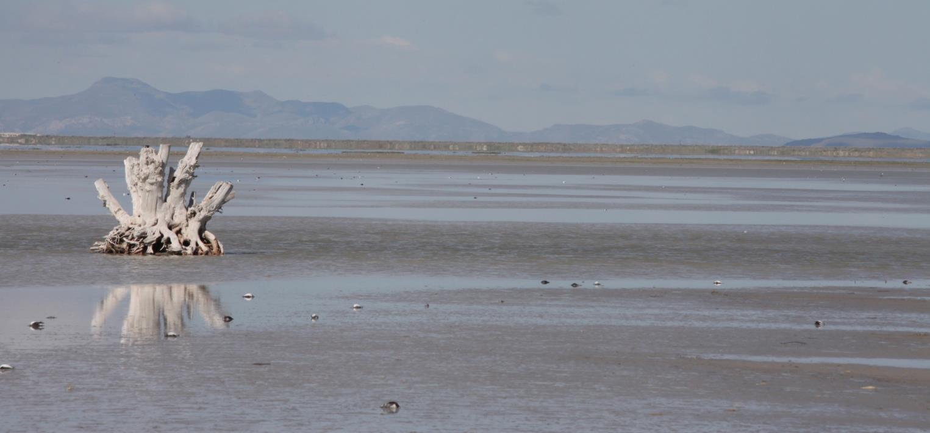
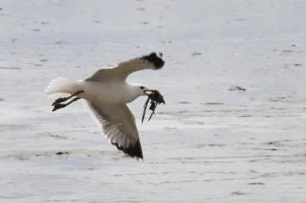
Stopover Hotspot – Great Salt Lake
Minimum count of 7,370 Red-necked Phalarope (Phalaropus lobatus) 3-days after hailstorm
Photos: John Neill, Utah DWR
Notes:
Direct mortality – but also setbacks (energy accumulation, injury) causing delays in departure

Slide 26
Severe Weather Exposure
Can occur throughout life-cycle
Potentially high-risk periods
  Nesting
  Molting
  Migratory stopover
  Roosting or other aggregations

Slide 27
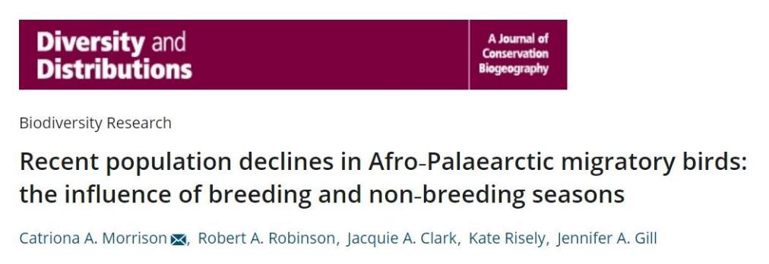
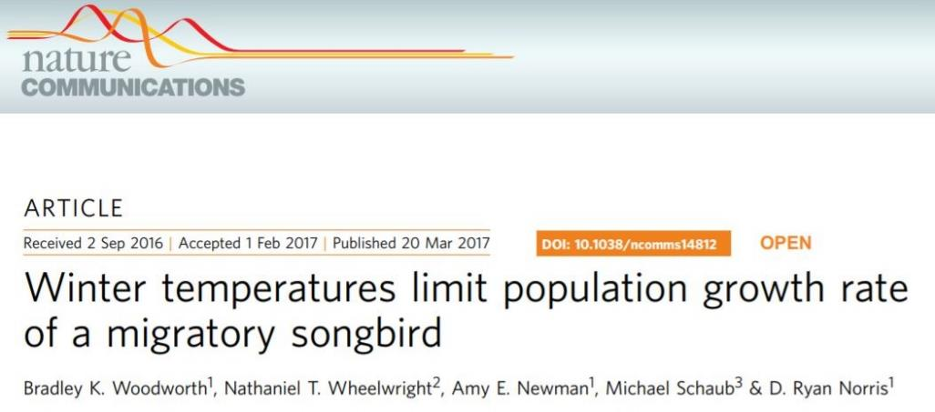
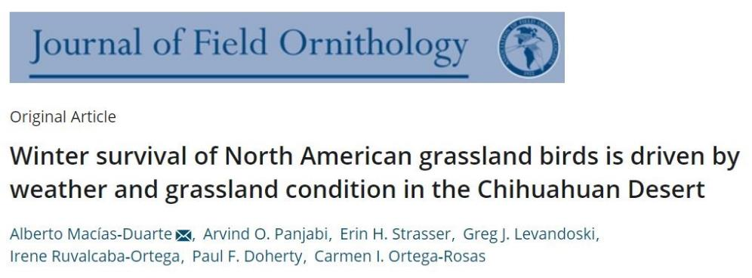
Increasing recognition of the importance of winter extremes for bird populations
Notes:
Historically conservation plans for migratory bird species have focused on the breeding grounds, and recently research has started showing that the winter period may play a significant role in population trends. Therefore, recently groups like partners in flight are now recognizing the importance and value of full life cycle conservation planning, but in order to develop and implement these types of conservation planning we need to know information about the full life cycle. Which is where my frustrations have come to bear because we don’t know basic life history information about the wintering ecology of these many of these migratory bird species that we are trying to conserve, how are we going implement strategies that are only relevant to a single season of their life cycle.

Slide 28
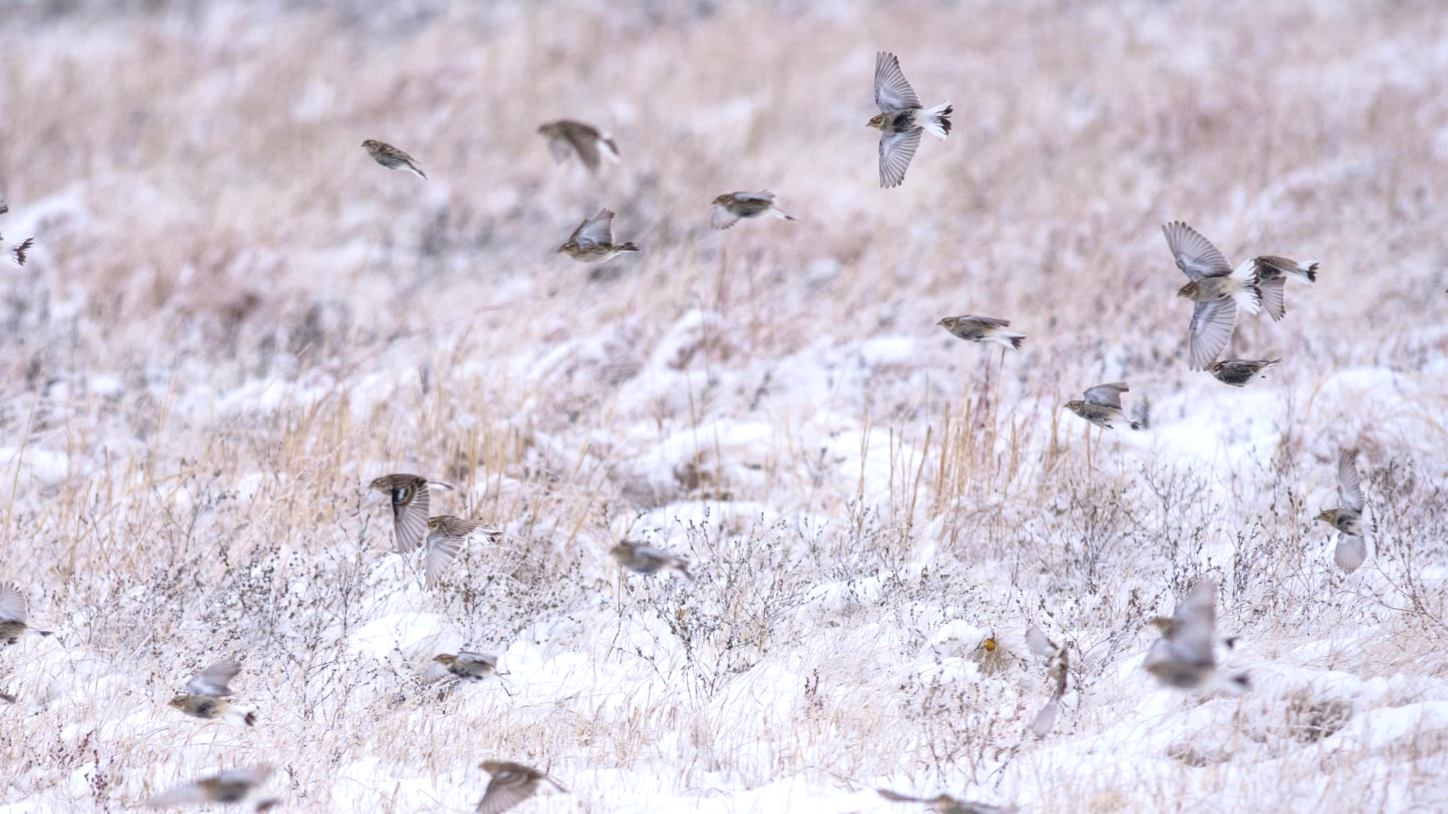
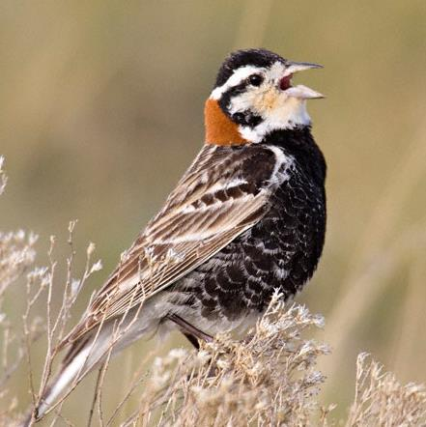
Chestnut-collared Longspur
89% decline since 1960’s
Oklahoma at heart of winter distribution

Slide 29
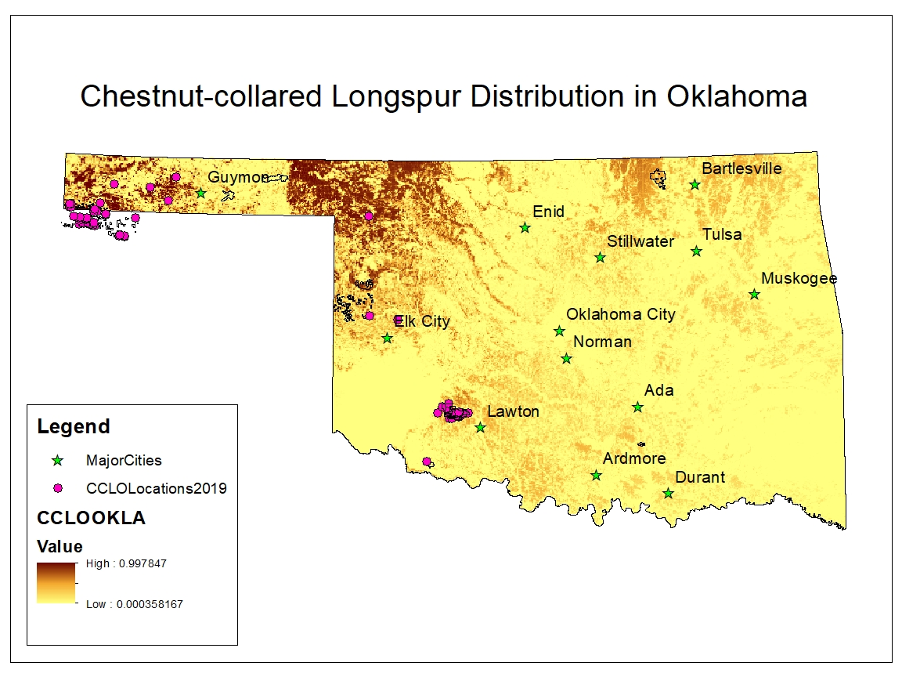
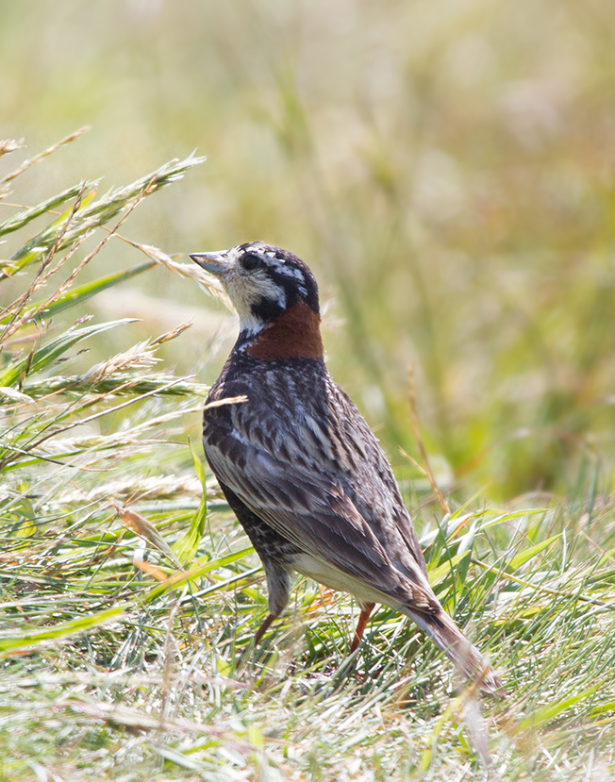
Notes:
In addition to the distance sampling which will allow us to estimate density and abundance, we also were collecting occurance data. This allowed us to use distribution mapping tools such as maxent to develop some preliminary distribution maps. Now these maps will be refined and added ontu, so consider these as a work in progress.

Slide 30
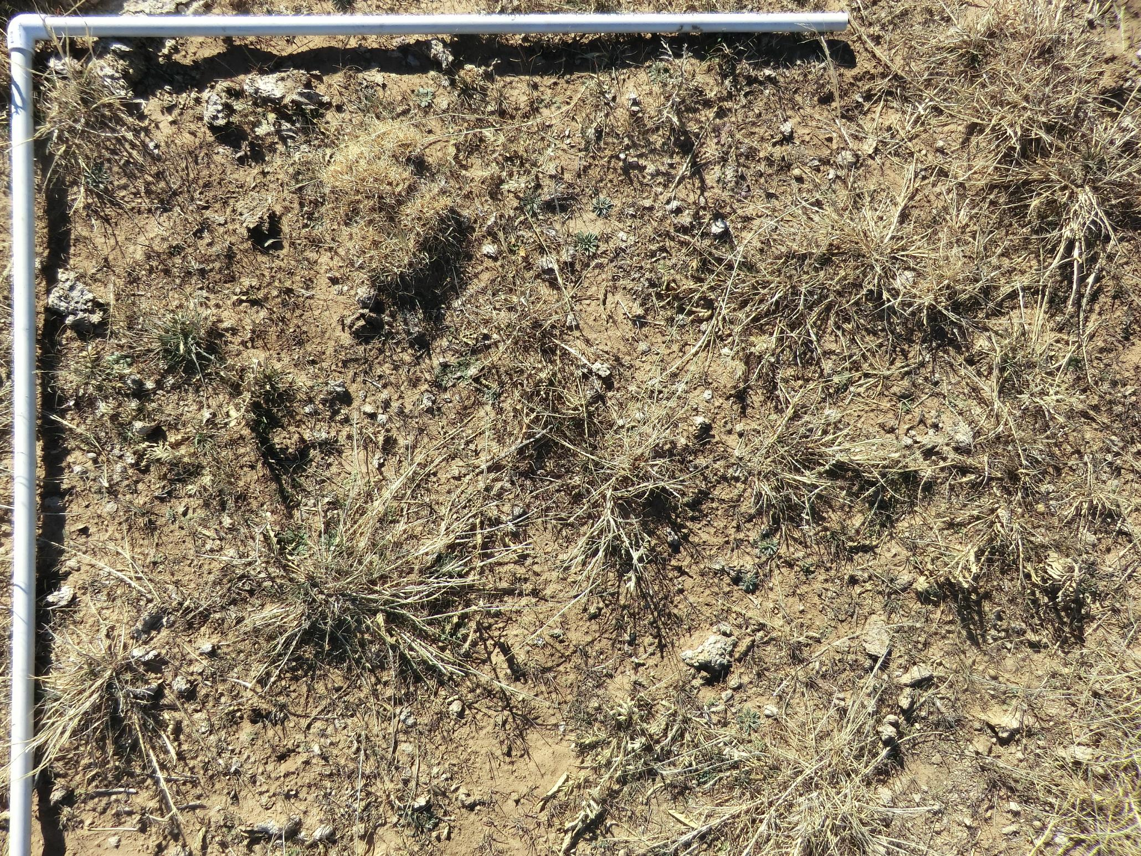


Slide 31
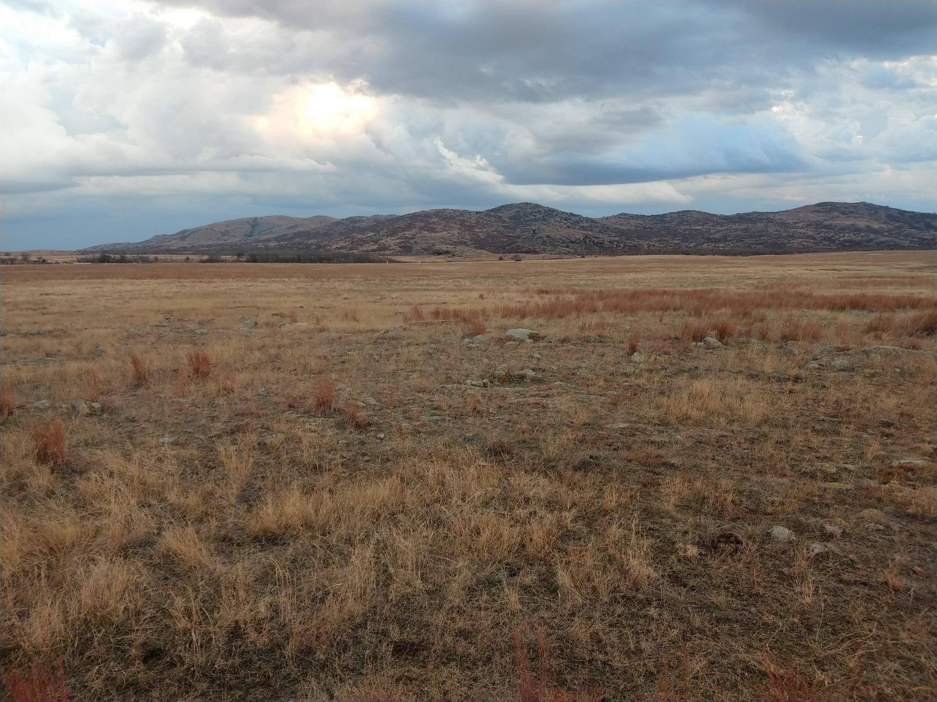

Chestnut-collared Longspur Habitat

Slide 32
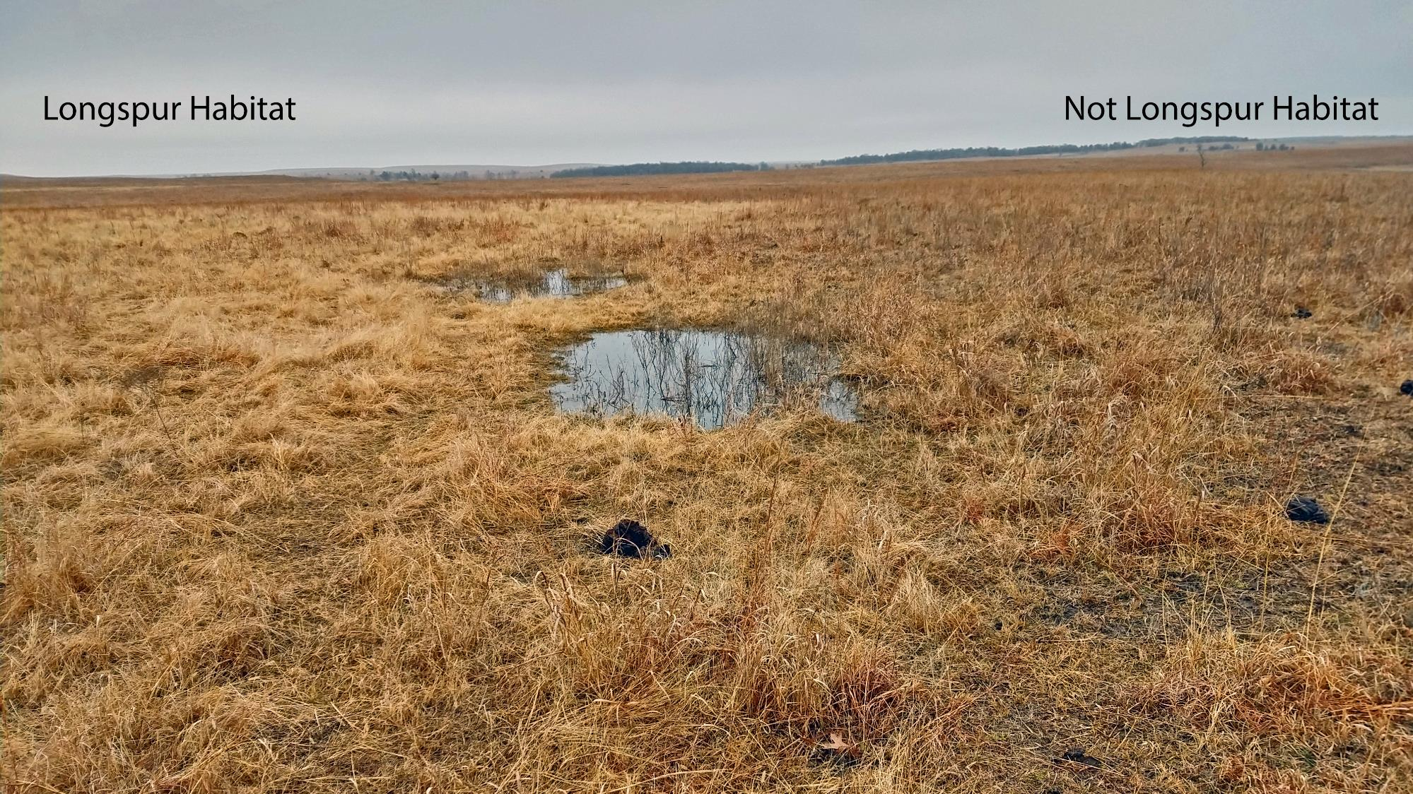
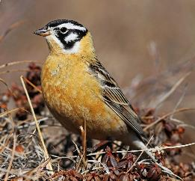
Smith’s
Notes:
Why I enjoy winter work

Slide 33
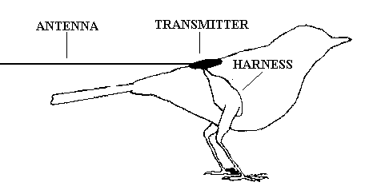
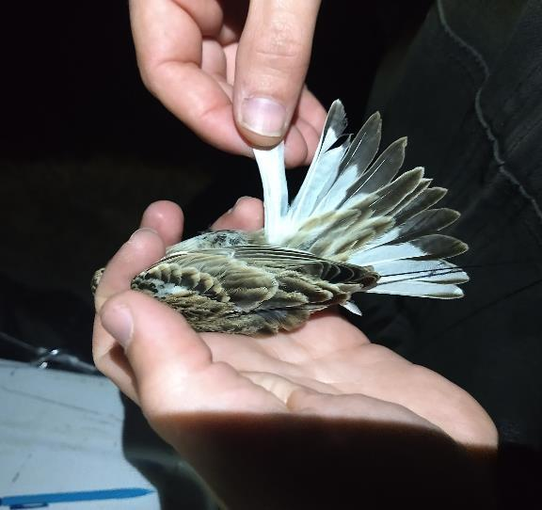
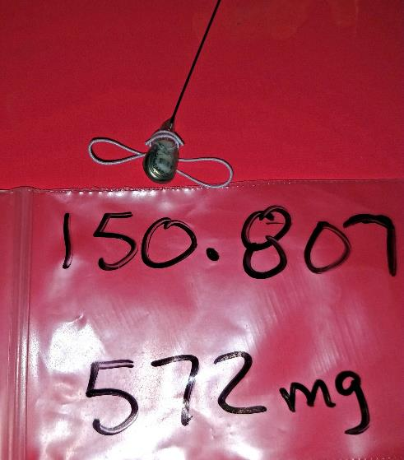
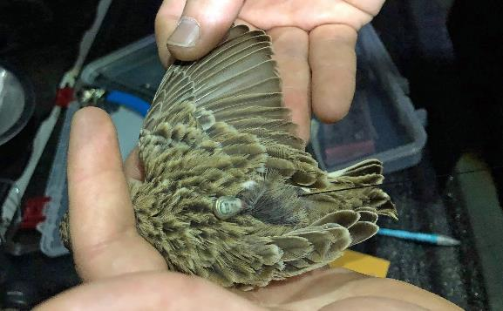
VHF Radio Tracking
Individual movements:
  Around home range
  Among habitats
  In association with other marked birds
  Changes with weather or progress of season

Slide 34
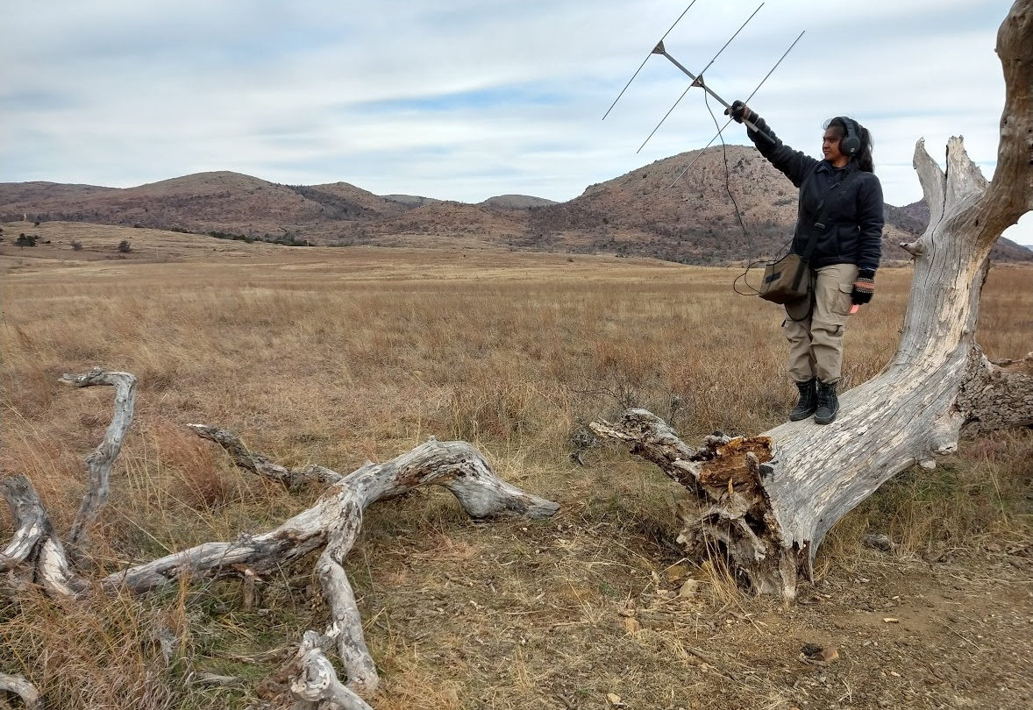

Slide 35
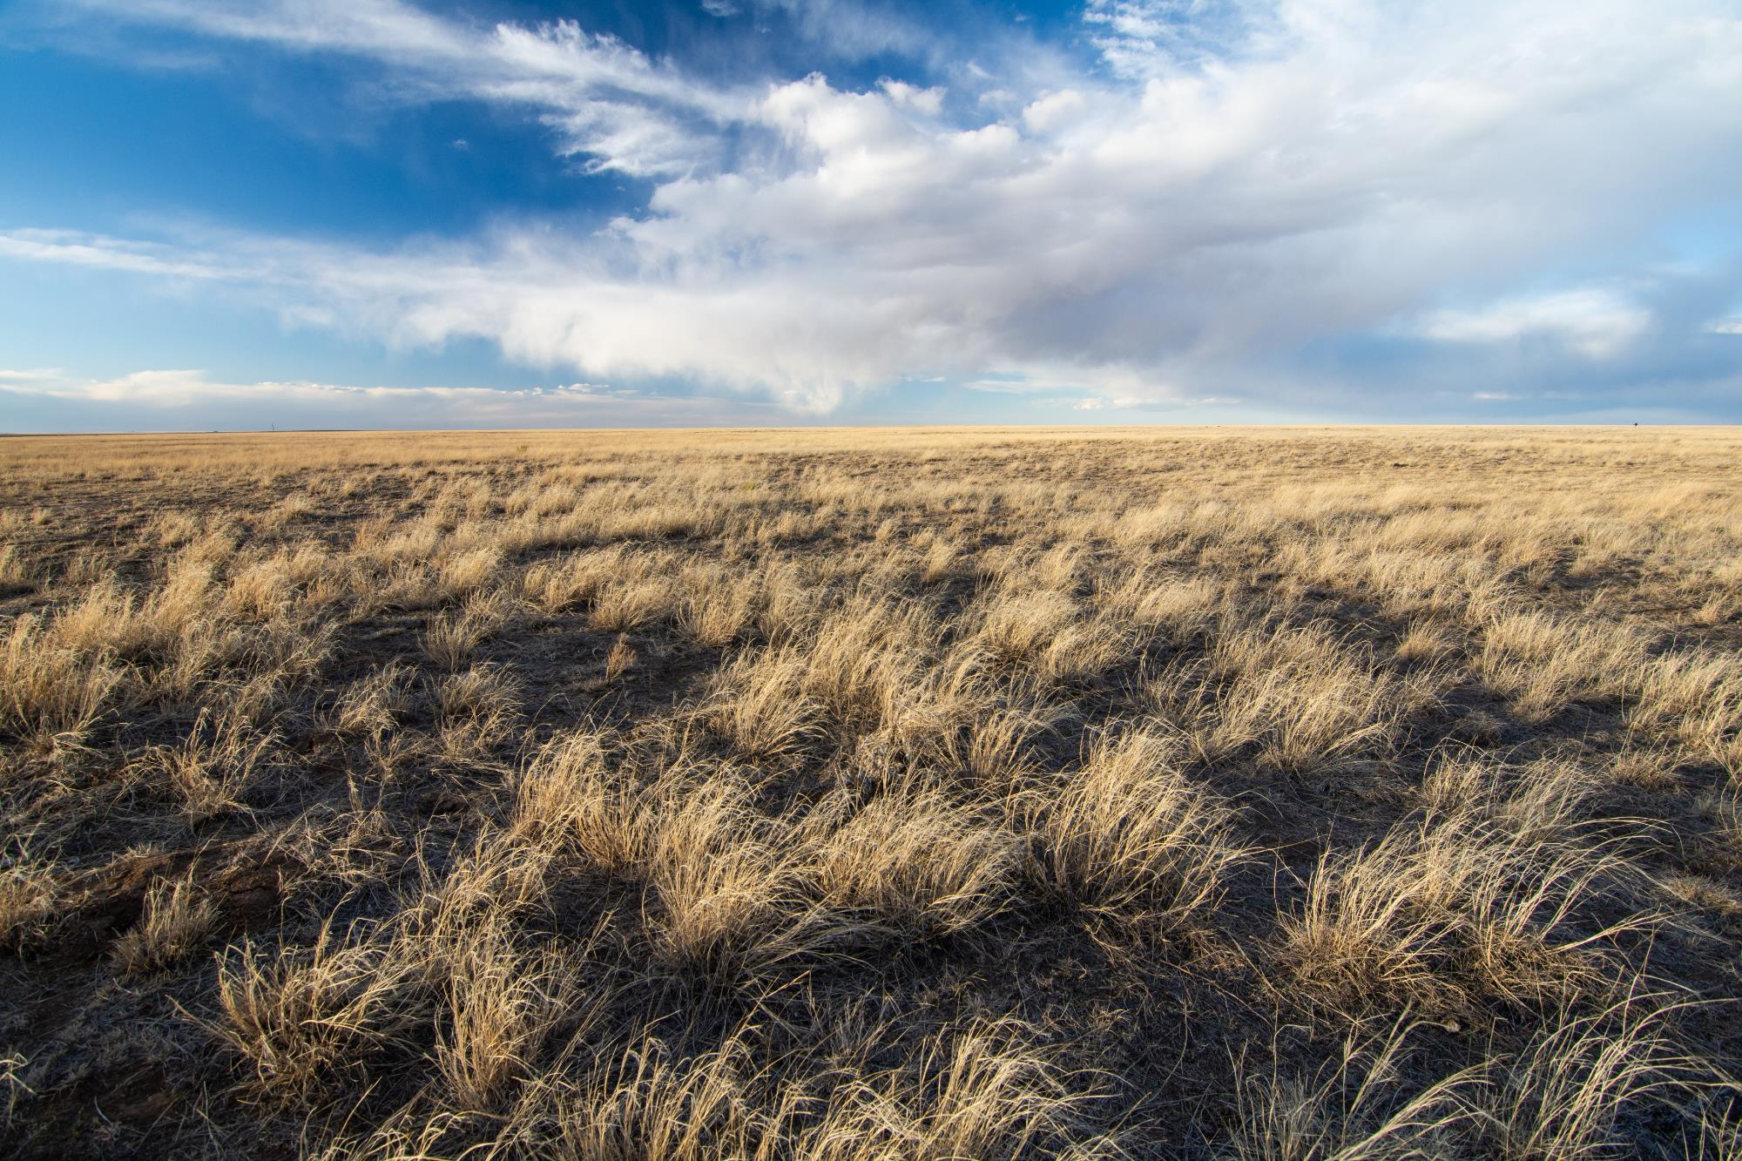
Longspur flocking behaviors
Solitary, wandering movements
Depends on resource needs, availability, and risks of accessing
Gregarious, resource tracking

Slide 36
Severe Weather Exposure
Can occur throughout life-cycle
Potentially high-risk periods
Sub-lethal impacts
  Developmental

Slide 37
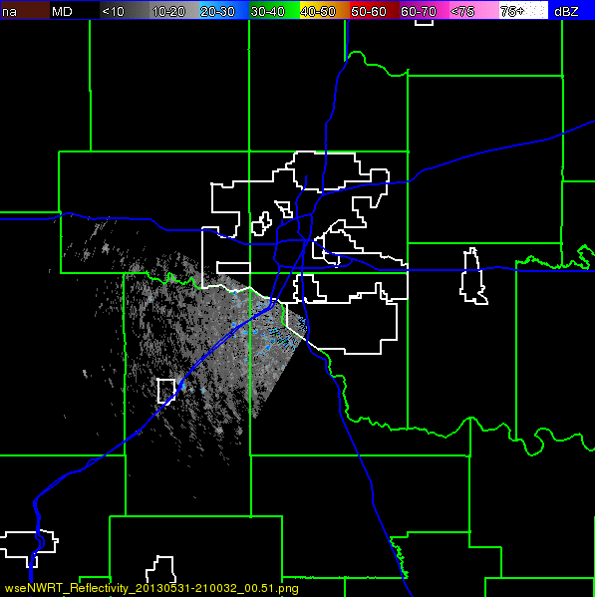
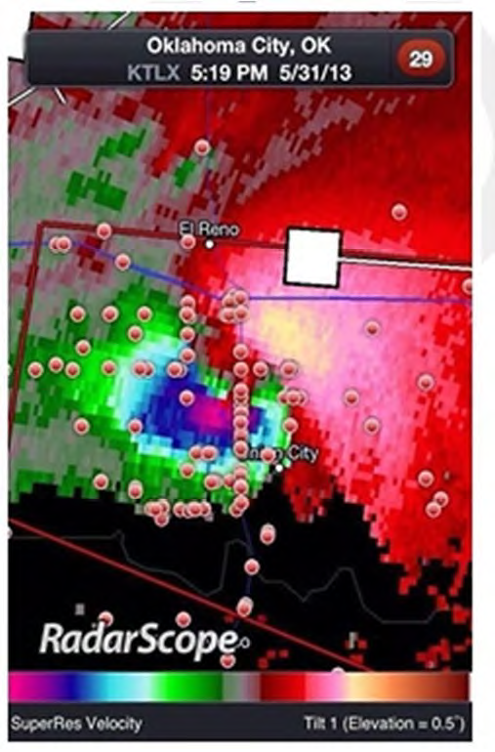
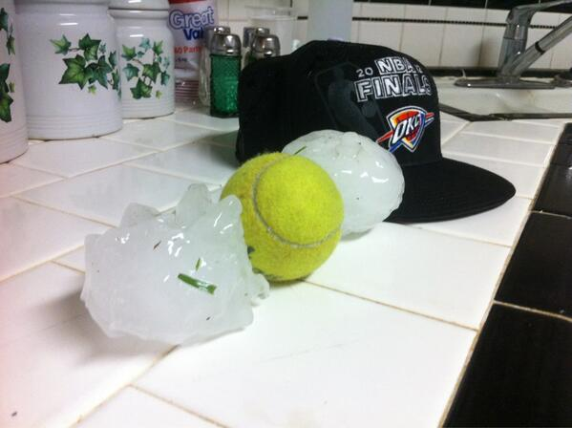
May 31, 2013 El Reno Severe Storm

Slide 38




Prevalence of Fault Bars in GRSP-HY
Fault bars found in 12 of 18 (66.7%) juvenile Grasshopper Sparrows captured in same field
Nearly double the highest prevalence rate previously reported for any bird species (38.5%; Møller et al. 2009)

Slide 39

Feather Structure in Fault Bars

Slide 40

Section Analysis of Feather Stable Isotopes
Sections 0.25-0.40mg each

Slide 41
Corrected δN₁₅ within FB Feathers
ANOVA
F ratio= 2.5146
p = 0.0930
Remained significant even when this outlier was removed
Residual δN₁₅
Residual δN₁₅
One-tailed
t-ratio = -2.24
p = 0.0151

Slide 42
Severe Weather Exposure
Can occur throughout life-cycle
Potentially high-risk periods
Sub-lethal impacts
  Developmental
  Behavioral

Slide 43



Avian adaptations to increasing aridity
Larger beaks with vascularization
Panting and shade use
Radiative heat loss
Notes:
Thermoregulatory behaviors (panting)
Vascularization helps reduce evaporative potential in the lungs because as they breathe in air it is cold relative to body temp, cools the blood vessels, and as they breathe out it warms it back up again

Slide 44


Beak morphology and thermoregulation (Tattersal et al. 2017)

Slide 45




The beak is a multi-tool!
Foraging
Thermoregulation
Singing

Slide 46

Bird song in arid environments
Horton et al. 2015
High pitch songs attenuate at hot and dry environments (Horton et al. 2015)
Singing more costly due to evaporative water loss (Ward and Slater 2005)

Slide 47



More aridity, more water loss, poorer sound transmission
Evaporative water loss
Temperature (C)
Attenuation
Relative Humidity (%)

Slide 48



How?
Relate daily song activity to:
Weather conditions
Supplemental water use

Slide 49
Impacts (and our ability to detect those) are likely to vary across species and individuals
Depending on:
  Adaptive anatomy or physiology
  Adaptive behaviors
  Habitat usage
  Age & Sex
For example …
  Thermal tolerance
  Escape or shielding behaviors
  Nest / refugia location
  Migratory arrival
  Vulnerable anatomy

Slide 50
Weather Ecology in Management
Why is this important and what can we do about it?
(aka, "so what?")

Slide 51
Understanding Resiliency and Recovery Potential of Species and Systems
Evolutionary predisposition to deal with periodic disasters
  How has this potentially been undermined by changes in climate regime and land-use?
Effective mitigative approaches for particularly vulnerable species or processes

Slide 52

Planning for Resilience and Recovery
Habitat management must consider all life-history needs of component species
  More than bedrooms, nurseries, and bathrooms
  Emergency plans not separate from core mission
Plan for the catastrophic:
  How will they escape a disaster and thereafter return?
  Could elements of the habitat become hazards during an ECE?

Slide 53


Equating mitigation of Severe Weather Impacts to Preservation of Natural Resources
Questions about Oklahoman's concerns about impacts of weather versus preservation of natural resources integrated into the Meso-Scale Integrated Socio-Geographic Network (M-SISNet) quarterly survey

Slide 54

Conclusions
Individual impacts of severe weather can have broad spatial and temporal impacts, especially within fragmented ecosystems
Emergency habitats and mitigation actions are important parts of management plans
An informed public will support you

